Slide 1
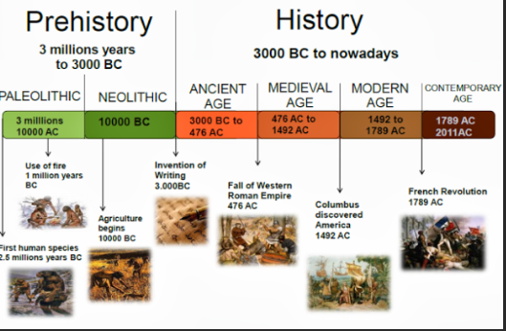
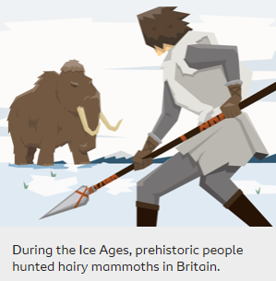

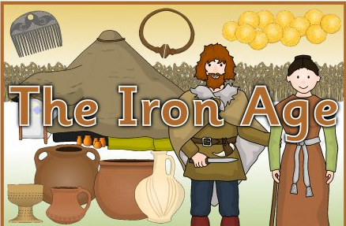
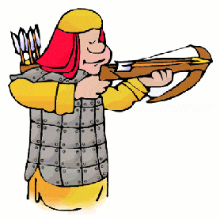
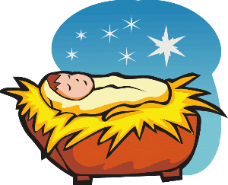
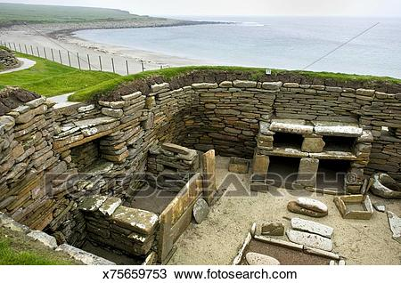
Topic Fact Sheet- Prehistoric Britain
Key Terms
prehistoric | The time in history between the Stone age and the first written records
Ice age | During the Ice Ages, Britain was covered by ice and snow
Stone Age | When the first humans began to live in Europe. They used stones as tools.
Iron Age | Humans now used iron to make tools, and farmed land instead of hunting. They lived in communities.
Bronze Age | In this era, metals were used to make hunting tools. Humans also began to farm land.
B.C. A.D. | Any dates before the birth of Jesus Christ Any dates after the birth of Jesus Christ
Stonehenge is a ring of stones in Wiltshire possibly used as a burial ground or calendar
Skara Brae a preserved Stone Age village

Slide 2
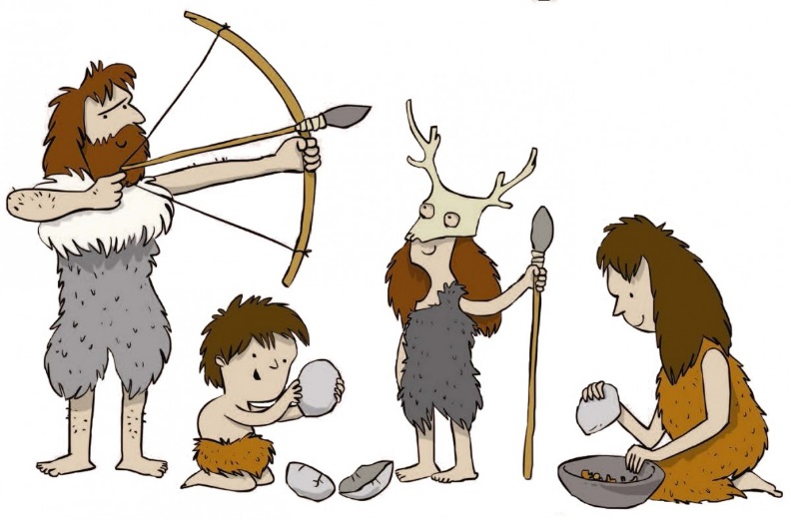
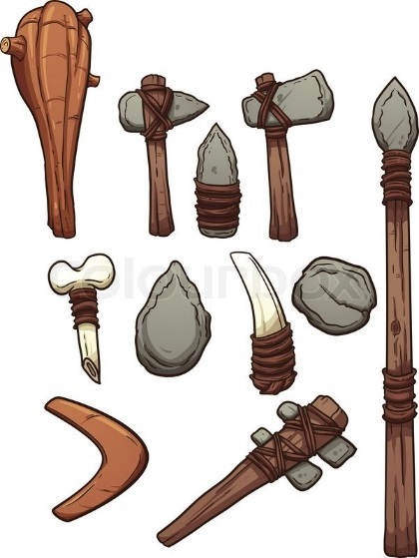
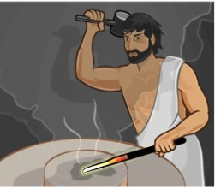
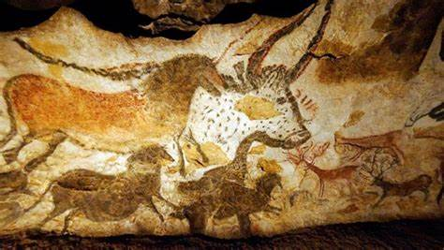
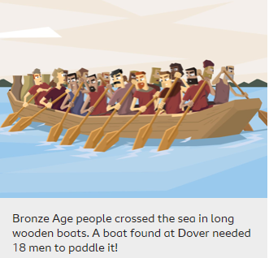
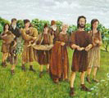
Topic Fact Sheet- Prehistoric Britain
Key Terms
Palaeolithic
Early Stone Age people hunted with sharpened sticks.
flint | A stone material for making stone age tools and weapons
hunter gatherer | A description of people who move about to hunt and gather their food
Lascaux cave paintings | Lascaux is in France and famous for its Palaeolithic cave paintings
bronze | A mixture of the metals tin and copper
They used animal skins to make clothes and shelters
Mesolithic
Middle stone Age people dug flint out of the ground, using antlers as a pick. They made weapons with which to hunt, and domesticated a wolf - the beginning of man’s relationship with dogs.
Neolithic
Around 6,500 years ago, a change took place in the way Stone Age people lived: hunter-gatherers settled in one place and kept animals and grew crops
Iron Age people in Europe lived in large tribes ruled by chiefs or kings and queens. Warriors were the most important people, and there were battles with neighbouring tribes
Cave paintings of animals were done to help people to survive

