Slide 1

A day in the life of our school library.
By Mrs Wells

Slide 2


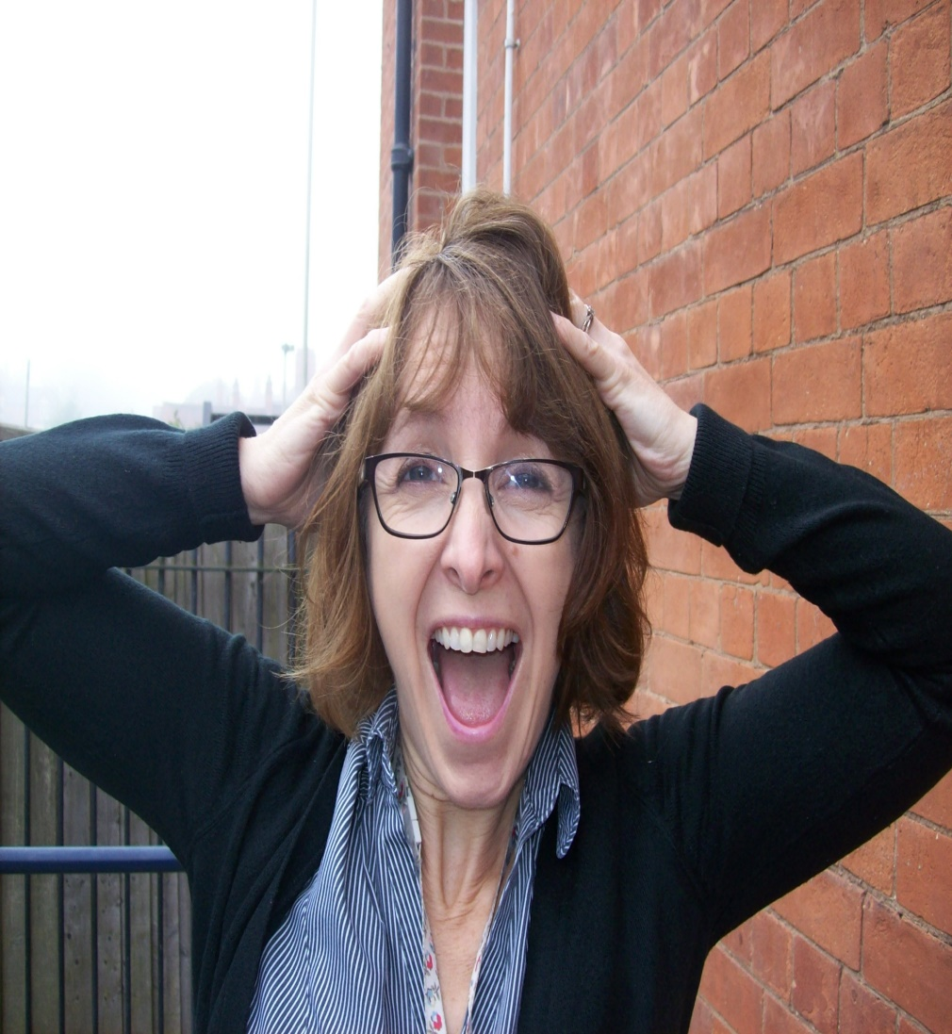
Once upon a time there was a school librarian called Mrs Wells.
Every Monday she entered the library ready to stamp new books to put on the shelves. She often imagined all the children who borrowed the books, sitting in class, being whisked away on amazing adventures.
Then one day…
horror strikes!

Slide 3
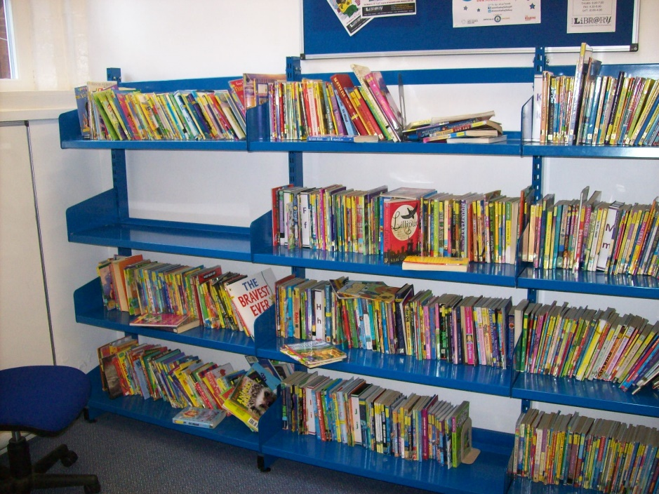
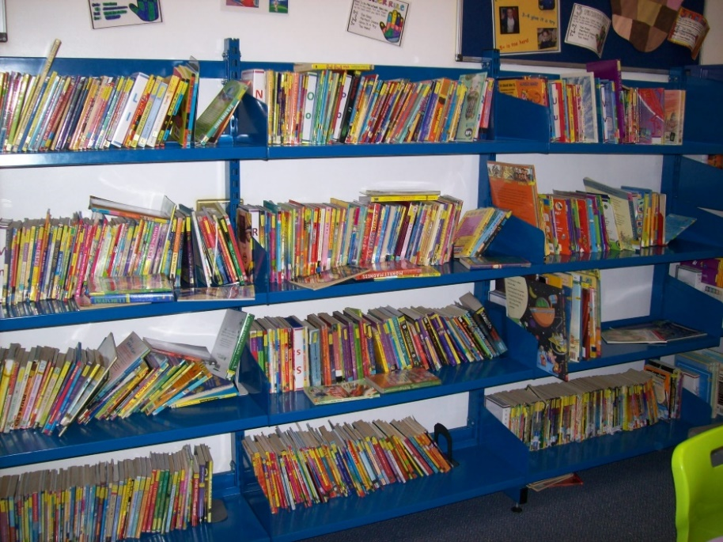
She walks into the library to find this:
pages ripped ,books mixed up, and filed under the wrong letter. The whole place looked like a jumble sale!
Books thrown onto the shelves; a whole shelf of books removed and put on the table;
Mrs Wells wept in despair…

Slide 4
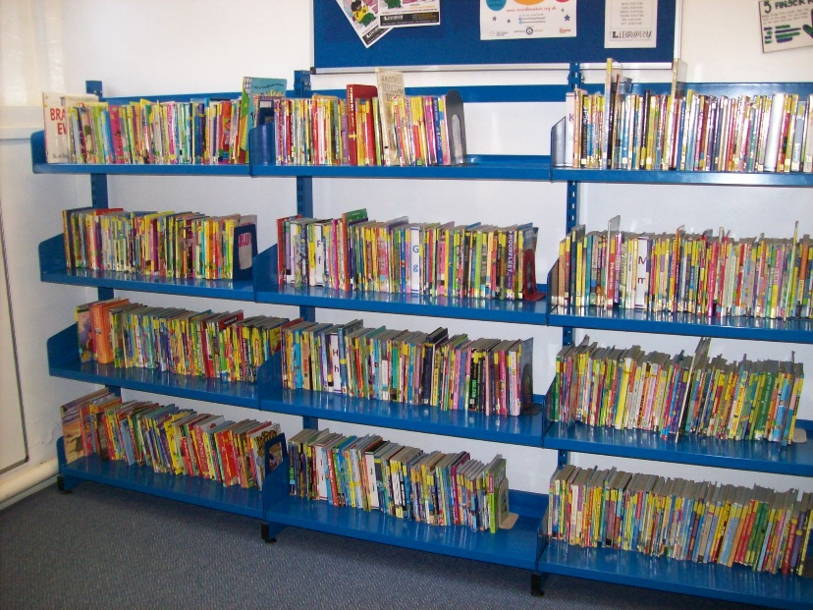
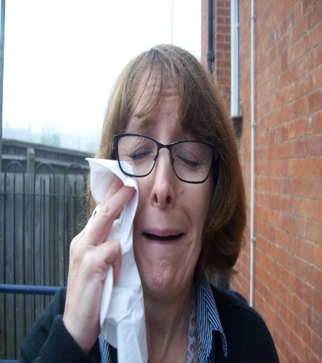
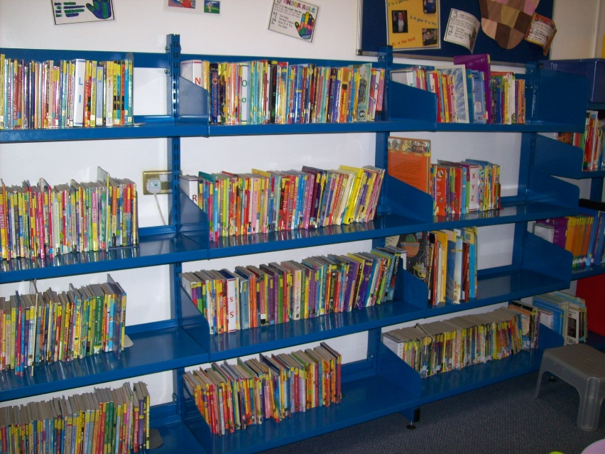
How was she going to get all the new books stamped and on the shelves? She simply wouldn’t have time.
She worked really hard to sort through all the books, push the bookends back into place and tidy it ready for the next day.

Slide 5
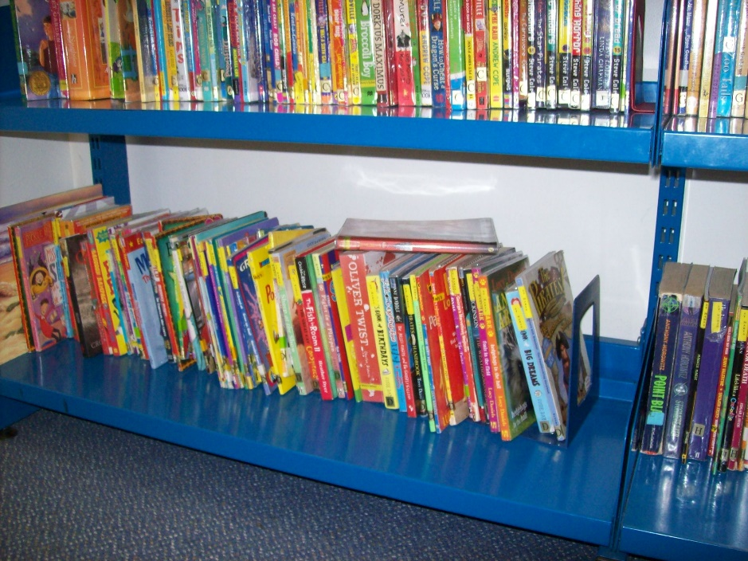
But Mrs Well’s knew that there were a group of library trolls, who wanted to make a mess of her lovely library. So, she decided to try to catch them in the act. She went into the library during the day and took photographs, to see if she could see what was going on?
And already there was a book left lying on top of some others.
On Tuesday morning at 9:00am she had a look in the library…
She wondered which one of the library trolls had done it?

Slide 6
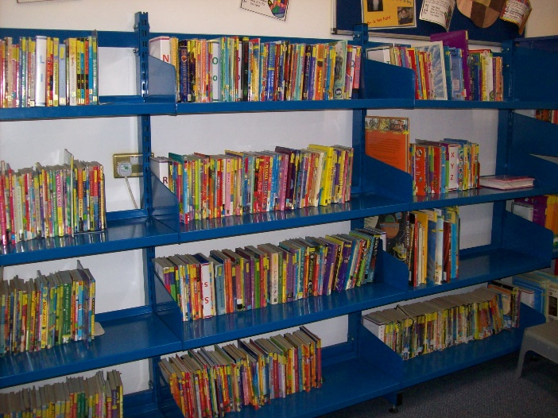
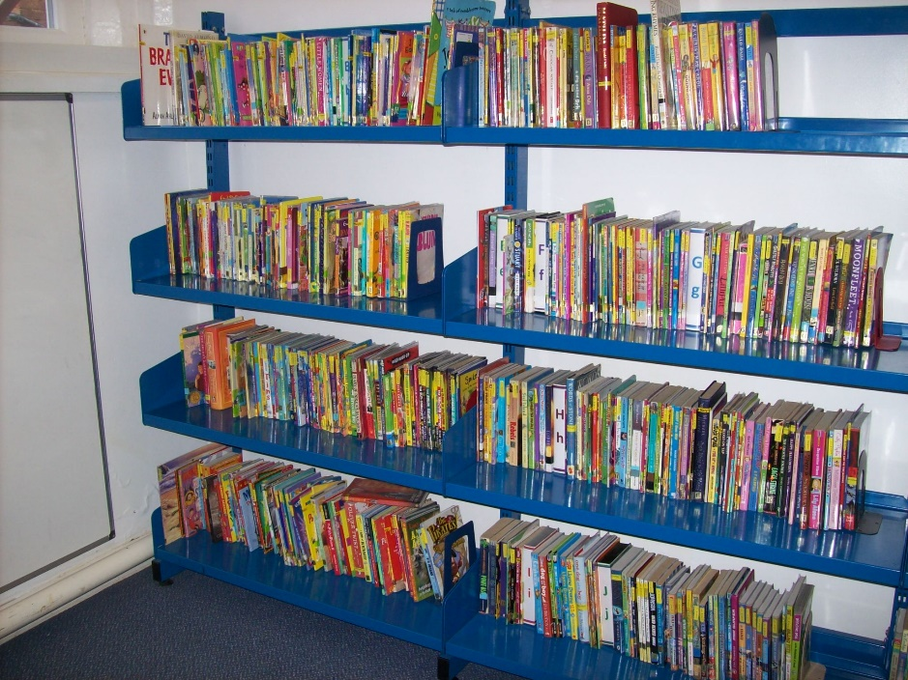
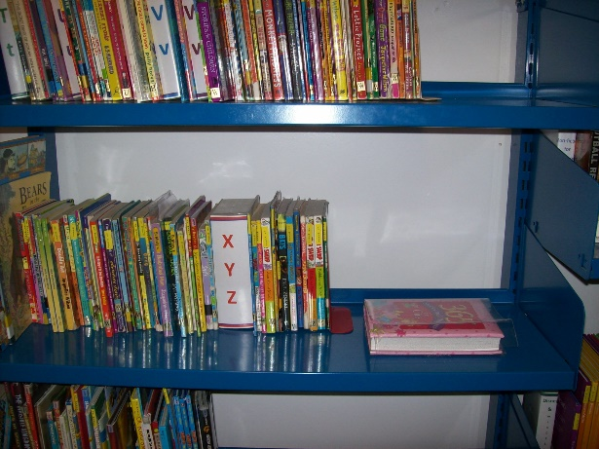
She went back at 10:00am…
The same book was still lying on the top.
This time another book had been moved and thrown on the shelf.

Slide 7
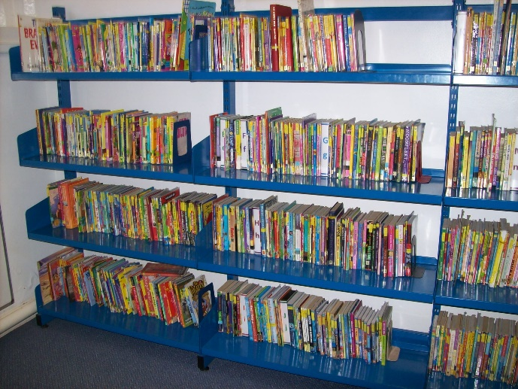
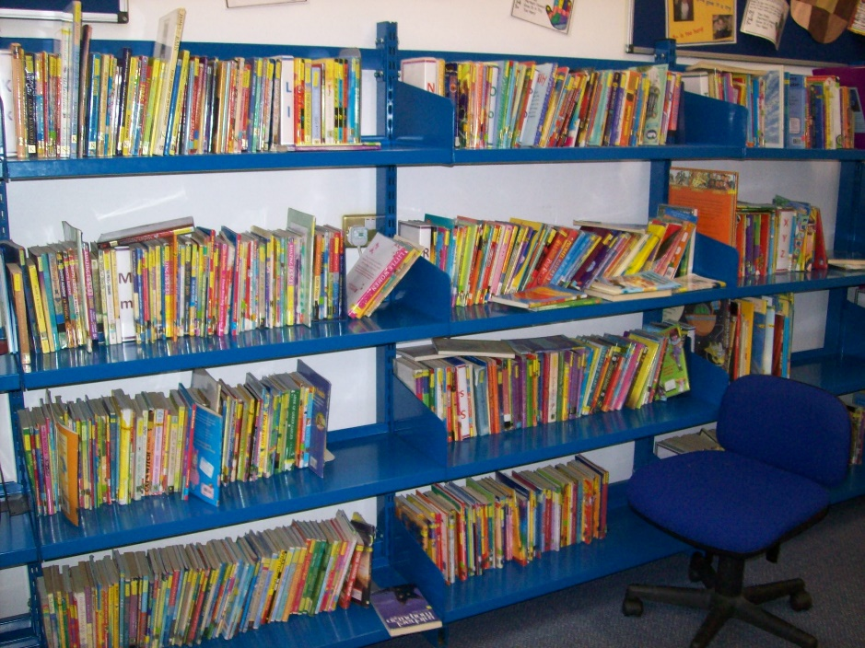
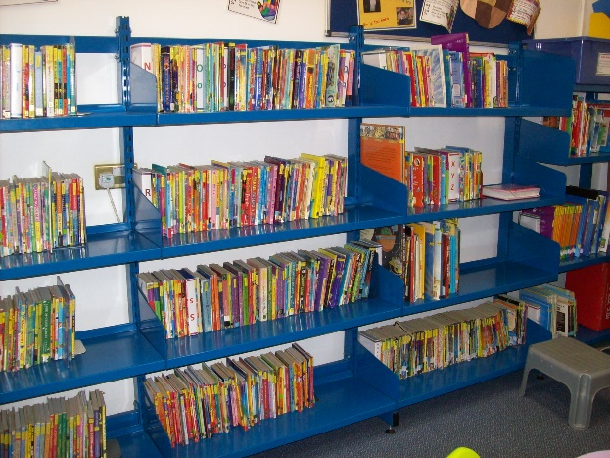
She went back at 11:00am…
She went back at 2:00pm
All was the same, but she realised that everyone was in maths.
Oh dear, the trolls have been in and left such a mess.

Slide 8
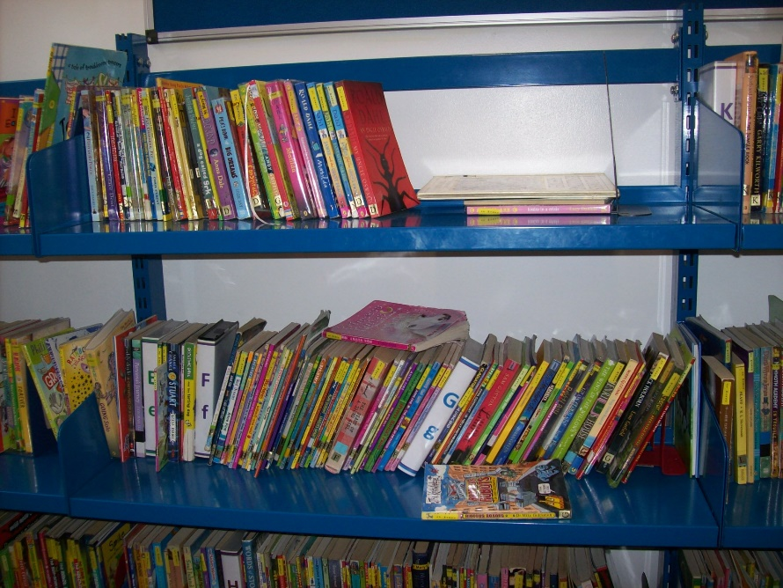
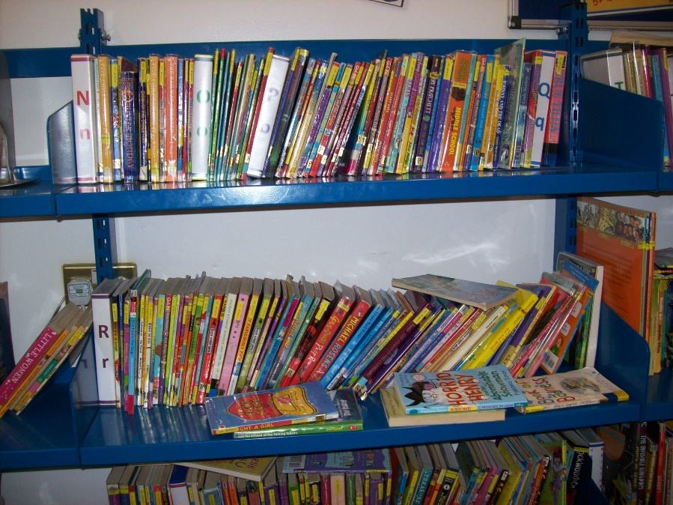
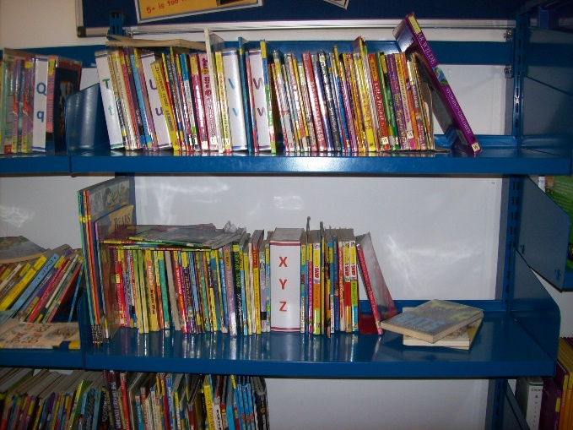
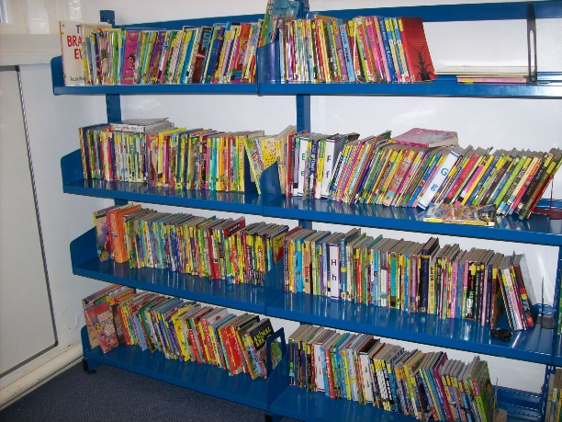
Even the handle on the teacher’s swivel chair has been broken off!
Books have been thrown on the shelves.

Slide 9
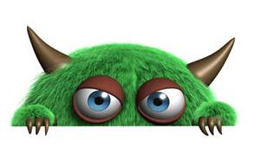
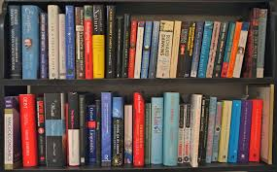
they have forgotten to be thankful for such a wonderful resource.
And so the story ends, exactly where it started. With Mrs Wells and her army of librarians, finding they have another giant task on their hands to tidy the library.
The trolls had managed to ruin the order in just 5 hours. Maybe you know a library troll or maybe you are one?
Our trolls have taken our library for granted. We can’t trust them to treat it well and

Slide 10
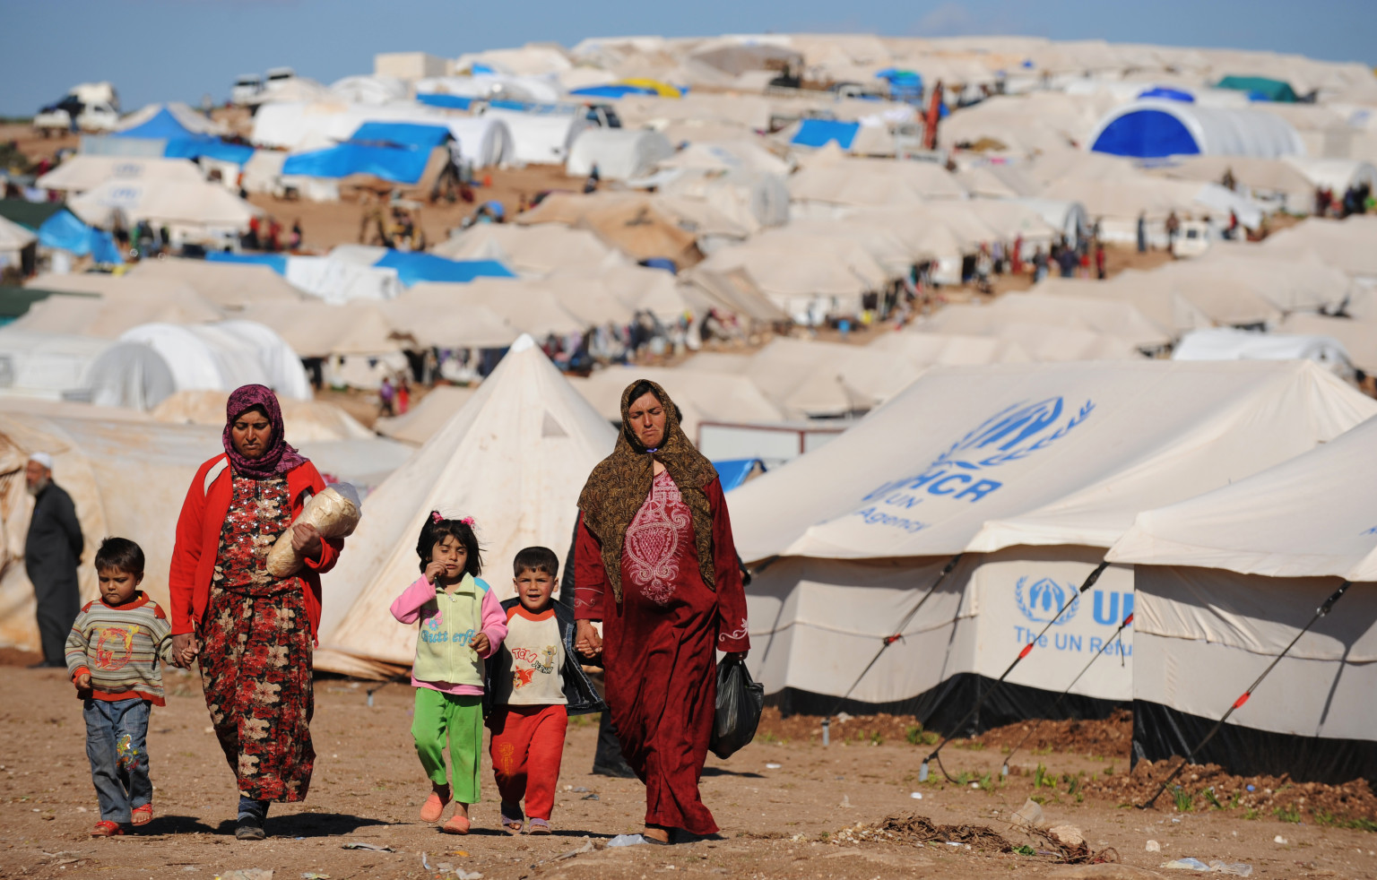
There are hundreds of thousands of children currently fleeing conflict. They leave carrying only a handful of possessions, not knowing if they will ever see their home again.
All they want is a normal life, food, shelter, an education and books to enjoy and learn from.
We have a lot to be thankful for!
The library is there to allow you to borrow books that will hopefully inspire you to read and develop as individuals. Be thankful and treat them with respect.

Slide 11
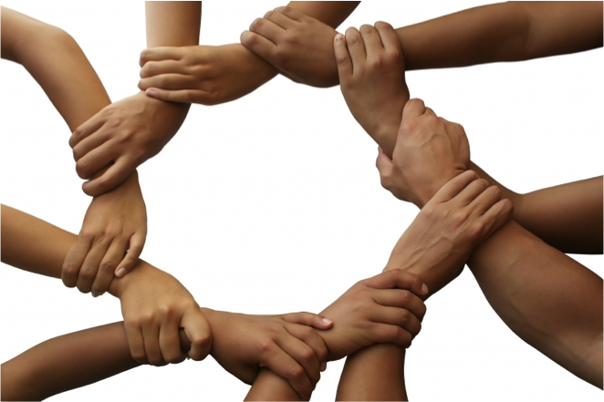
Keep the shelves tidy.
Make sure other users use the library properly.
Put books back in the correct place.
All libraries work on TRUST with its staff and users working as a team. What sort of things do libraries trust its users with?
Ask questions if you’re not sure.
Treat the books with respect.

Slide 12

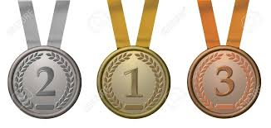
Record Breakers
From 11th July - 5th September 2015
For 4-12 year olds
Westfield Juniors
24%
St Margarets
Stoke Golding
52%
Battling Brook
19%
We had 48 children complete the challenge out of a total of 306 pupils in school.
We had 15% of our school complete the challenge. If we had 62 finishers we would have come third.

Slide 13

18 January to 15 April 2016
Last year we read 3580 books last year, average of 20.1 books per child
There are school prizes to be won as well as individual and class prizes.
All of KS2 have been allocated a log in and password, letter to go out in the next few days.
You must only log on books you have finished reading fromtoday! Books are available on line to read and should work on more devices this year!!
We will run a separate competition towards the end of the competition for KS1 – details to follow.

