Slide 1

2016 Results
https://www.youtube.com/watch?v=h5F5Kdc1UVA

Slide 2
READING GROUP STATS
STUDENTSIN YOUR GROUP 179
AVERAGE BOOKS READ PER PUPIL 58.3
BOOKSREAD AT YOUR SCHOOL 10,441
BOOKSREAD IN YOUR REGION 72797
Books read in total in the u.k 594,663
14.38% of the reads for the East Midlands region.
1.7% of whole UK

Slide 3
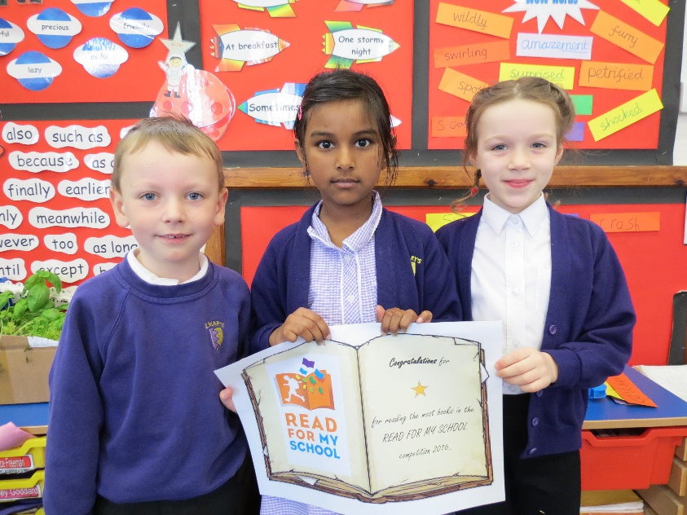
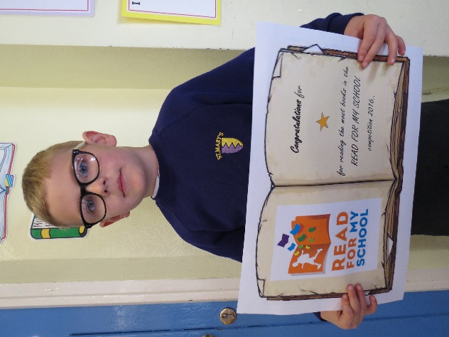
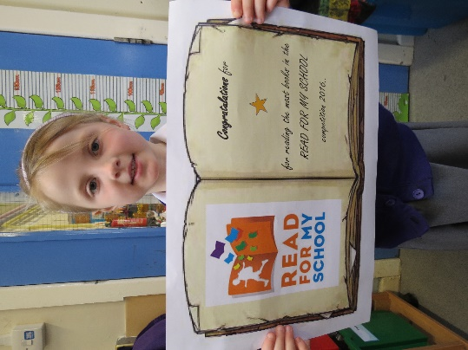
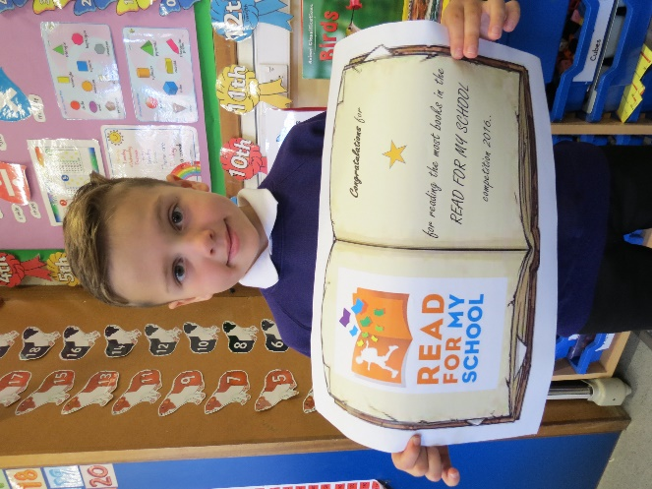
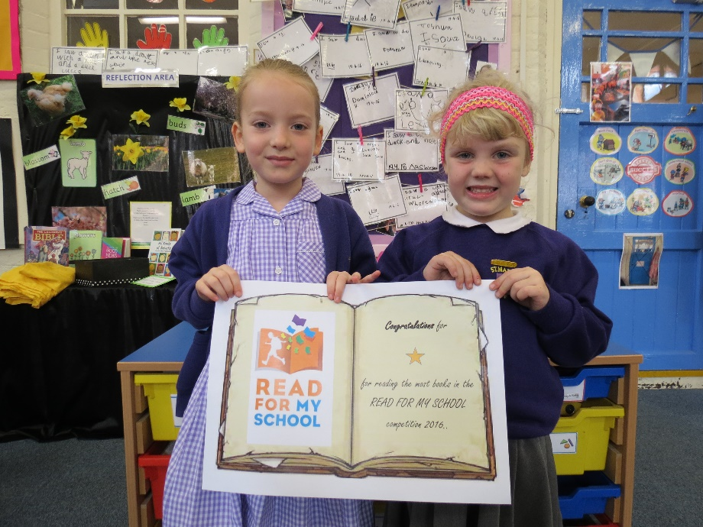
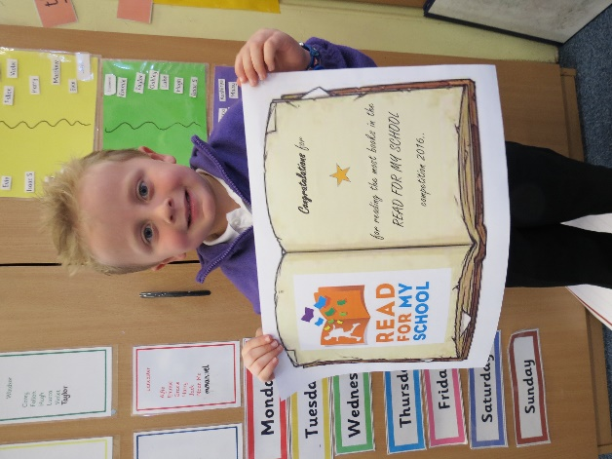
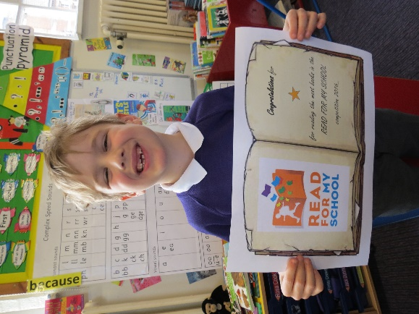
KS1 individual awards

Slide 4
600
KS1 Class Prize
Mrs Mose-dale
566
Miss Barnes
497
1st
Mrs Mosedale
Mrs Corley/Mrs Marvin
332
Number of reads per class
Mrs Owen
284
Mr Cramp
147
0
Name of class

Slide 5
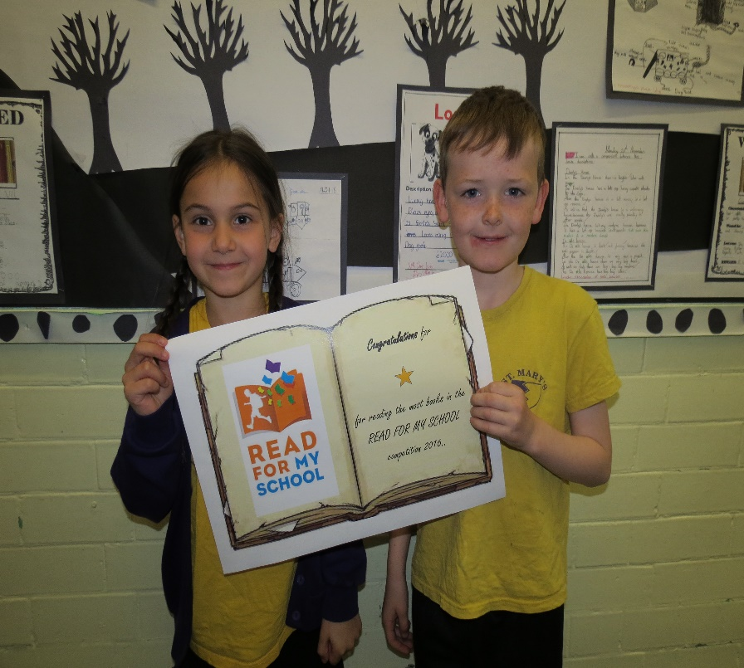
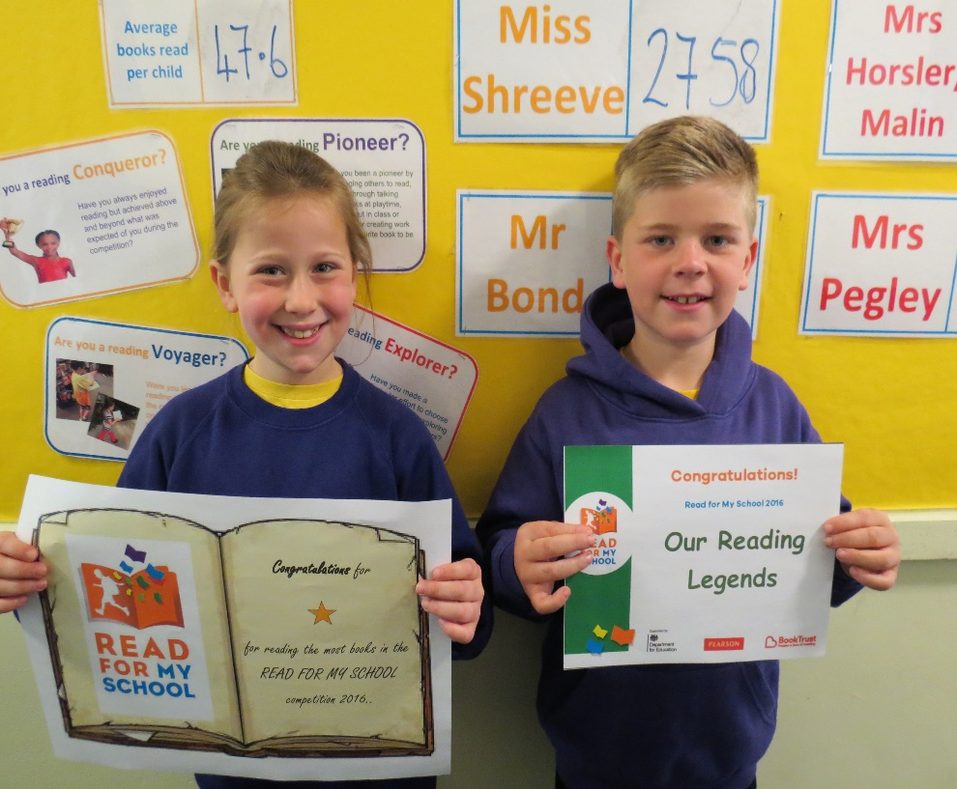
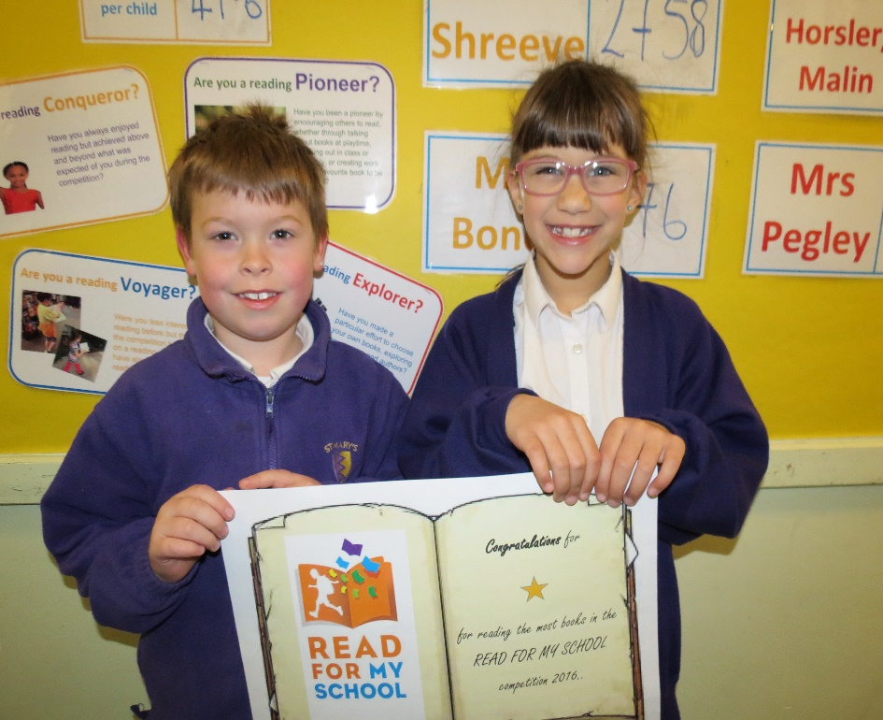
Year 3/4 individual awards

Slide 6
Years 3/4 Class Prize
4100
Mrs Talbot
4078
1st
Mrs Talbot
Miss Shreeve
3405
Number of reads per class
Mr Bond
856
0
Name of class

Slide 7
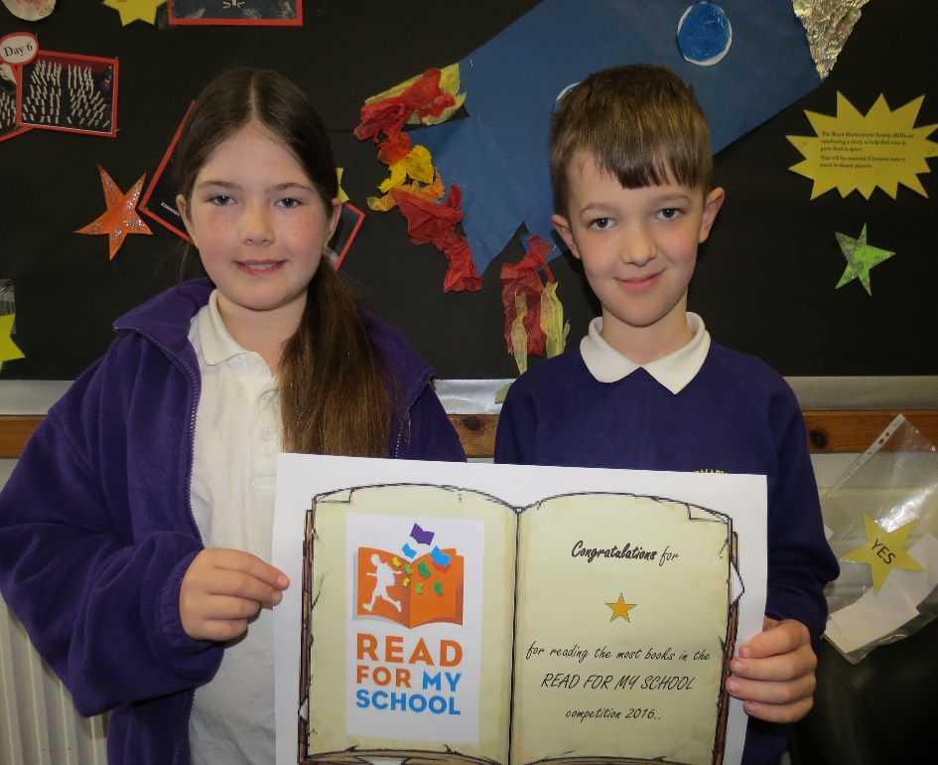
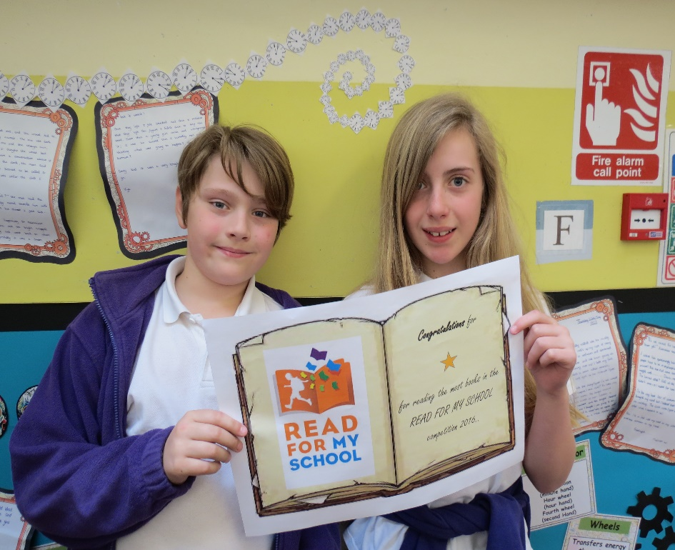
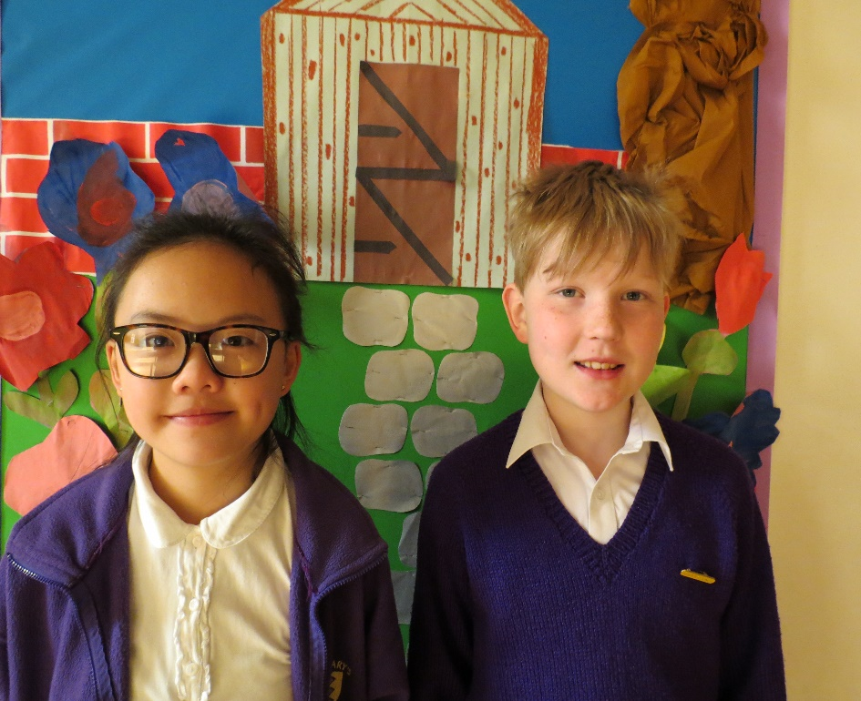
Year 5/6 individual awards

Slide 8
Years 5/6 Class Prize
850
Mr Roper
848
1st
Mr Roper
Mrs Pegley
676
Mrs Horsler/
Mrs Malin
578
Number of reads per class
0
Name of class

Slide 9
Individual nominated reading legends

Slide 10
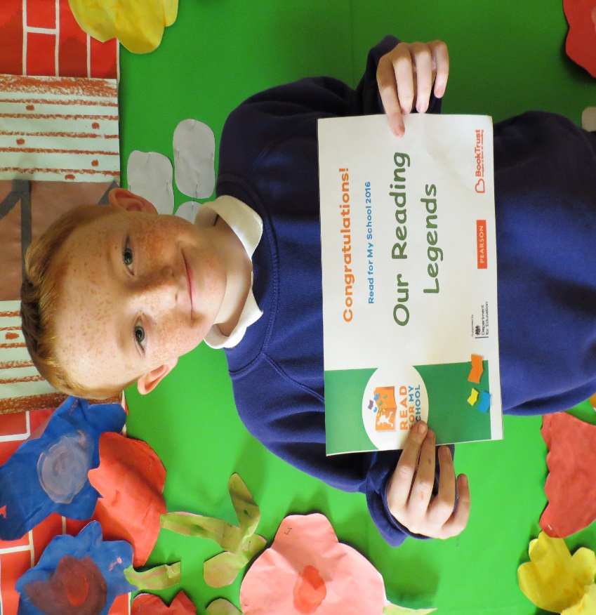
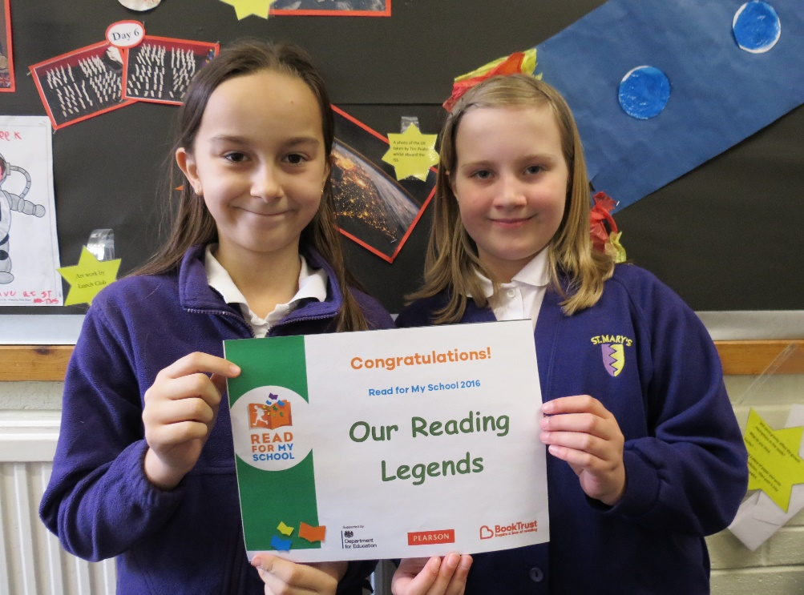

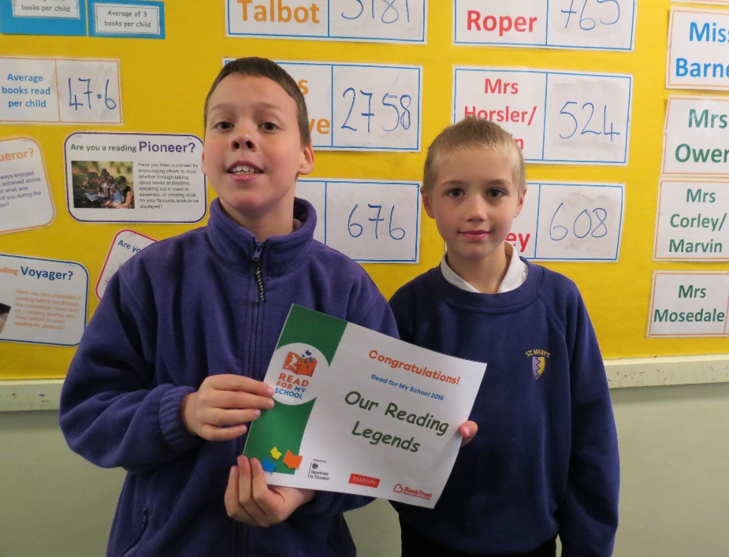
Conqueror
Explorer
Explorer
Voyager
Voyager
Conqueror
Explorer

Slide 11
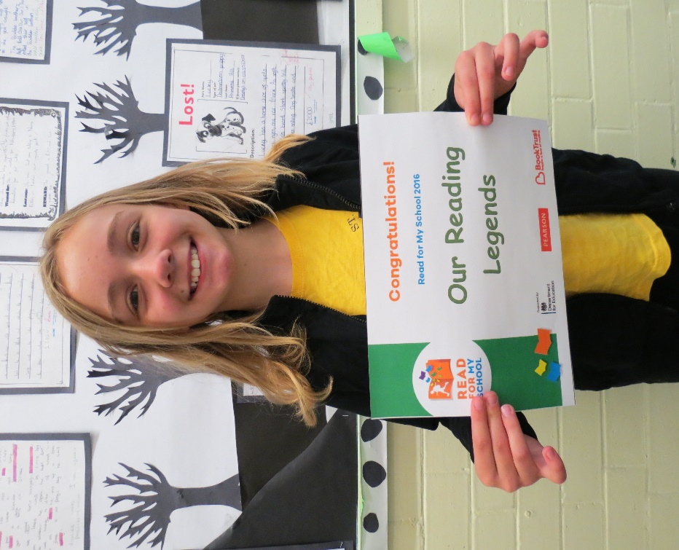
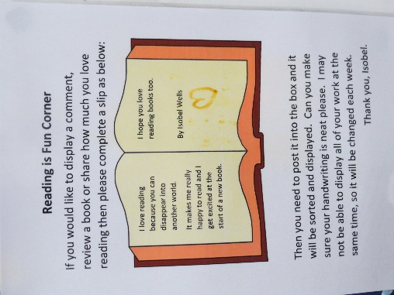
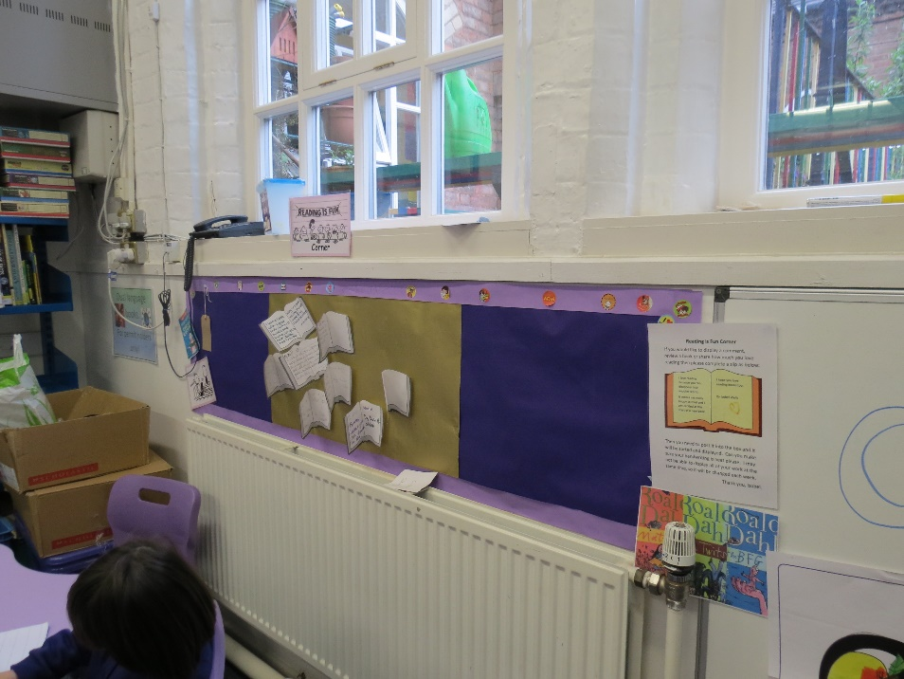
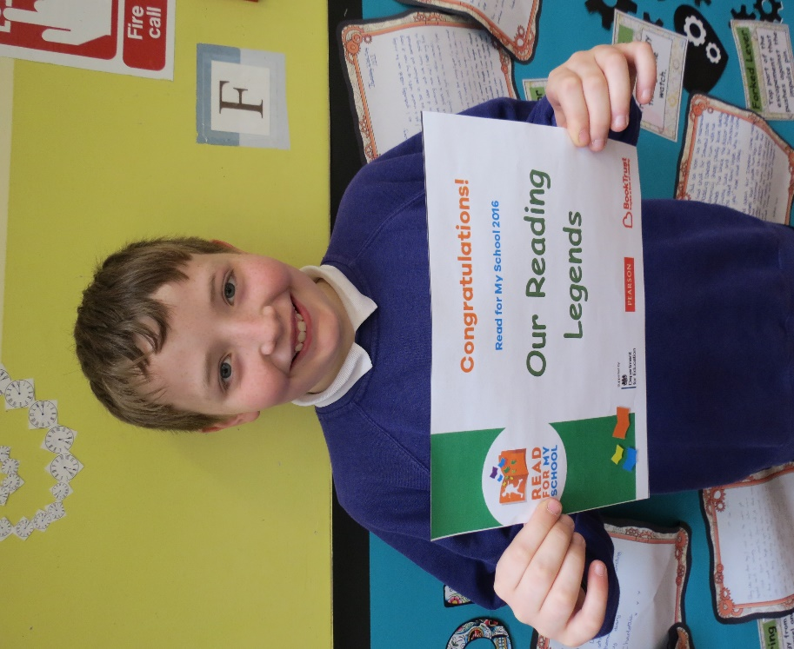

Pioneers

Slide 12

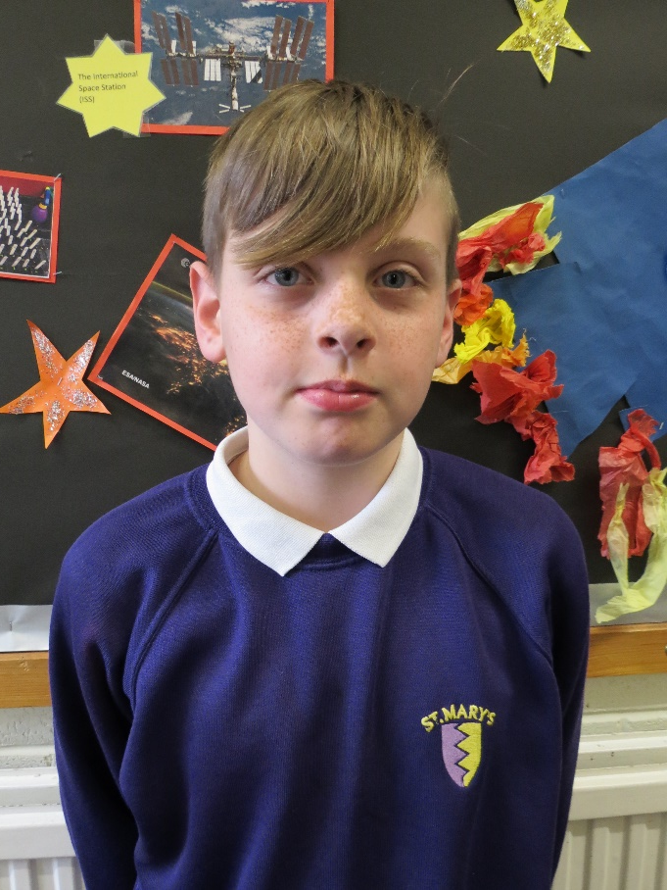
LCFC Voucher Draw
 |  | Wk13 | No of books read by boys | % books read by boys per class
Mr Roper |  | 848 | 453 | 53.42%
Mrs Horsler/Malin |  | 578 | 187 | 32.35%
Mrs Pegley |  | 676 | 351 | 51.92%
Mrs Talbot |  | 4078 | 1089 | 26.70%
Mr Bond |  | 856 | 332 | 38.78%
Miss Shreeve |  | 3405 | 1410 | 41.41%
 | Total | 10441 | 3822 | 36.61%
 | Average per pupil | 58.3
Winner of the prize draw

Slide 13
2016
The competition is over for another year.
In total you have read 11,660 books.
Thank you for taking part so enthusiastically!

