Slide 1


Slide 2
Thank you
Scholastic Book Fair

Slide 3

Before I start…
Breathe in!

Slide 4
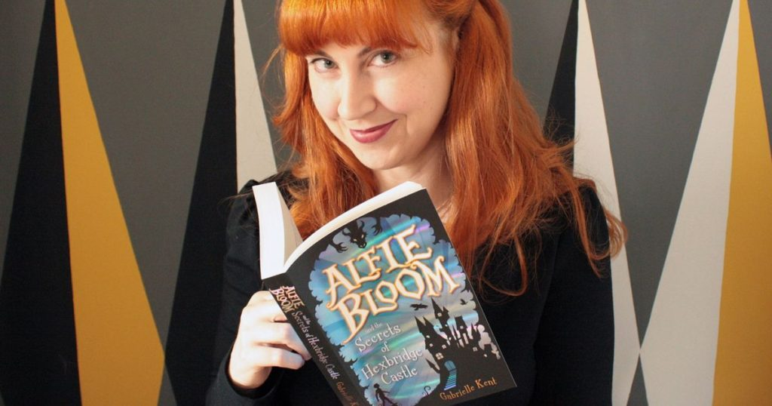
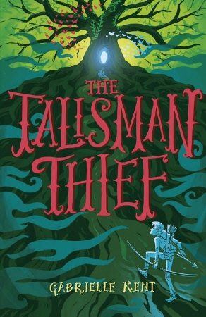
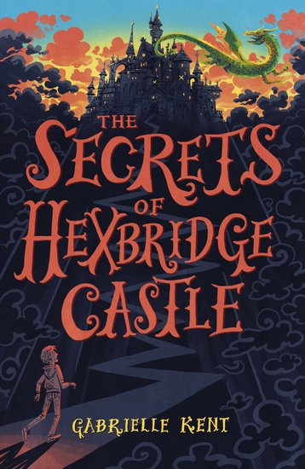
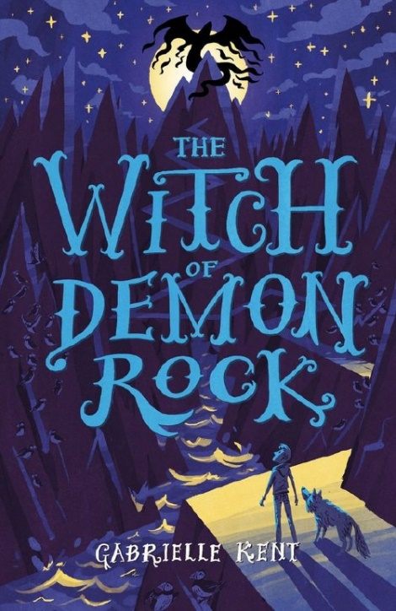
Gabrielle Kent Books

Slide 5
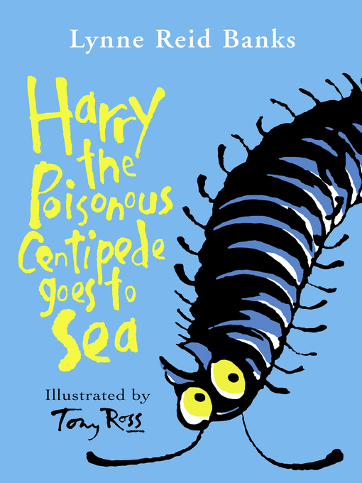
Harry the Poisonous Centipede goes to Sea by Lynne Reid Banks
Reviewed by Mr Cramp
If you like weird, fun adventures this is the book for you. It’s about the life of two rare centipedes – it reminded me of the film ‘The Secret Life of Pets’ too!

Slide 6
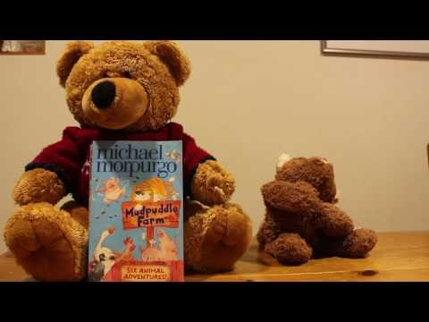
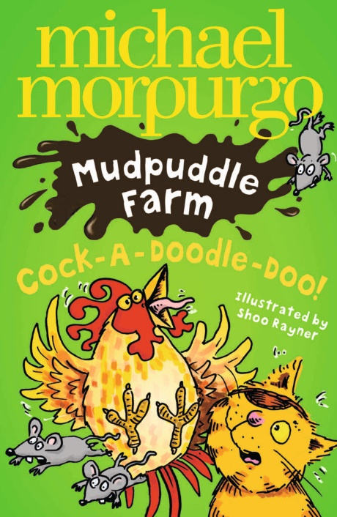
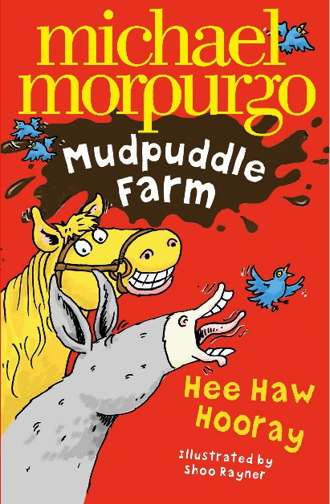
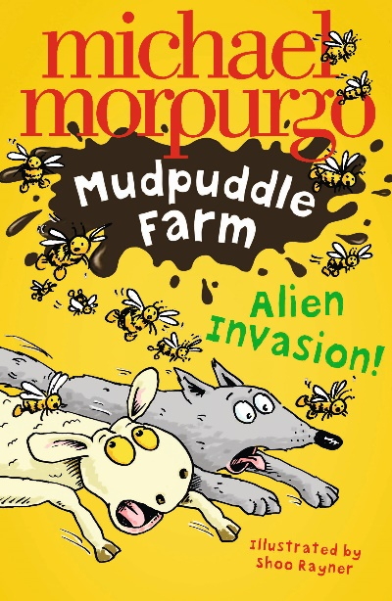
Mudpuddle Farm – Michael Morpurgo

Slide 7
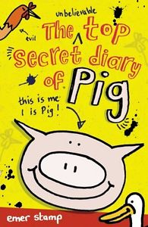
The Top Secret Diary of Pig reviewed
by Mrs Bardon Marshall and her son
‘We would recommend this book to anyone who enjoys a funny story, particularly about farting!’

