Slide 1
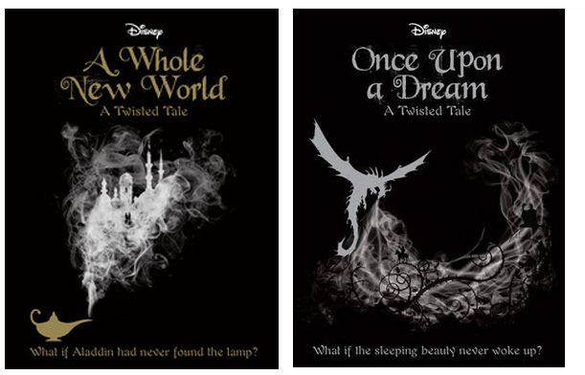
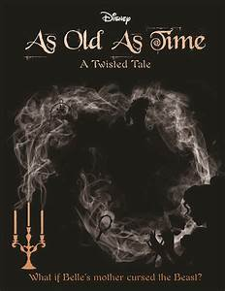
Disney Twisted Tales – Liz Braswell

Slide 2
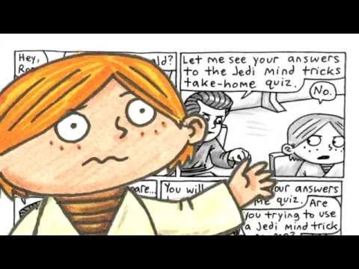
Star Wars Jedi Academy – Jeffrey Brown

Slide 3




Slide 4




Susie Day

Slide 5

His Dark Materials – Philip Pullman
Use the link below to video:
https://www.youtube.com/watch?v=PKi0upZnbqc

Slide 6





Mrs Wells Challenge - 5 reviews in 2 minutes

Slide 7
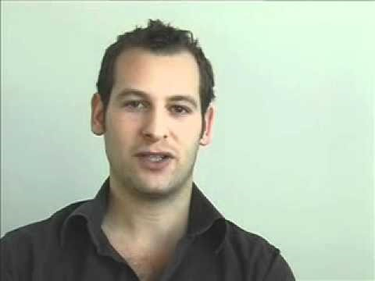

Jamie Johnson Books – Dan Freedman

