Slide 1
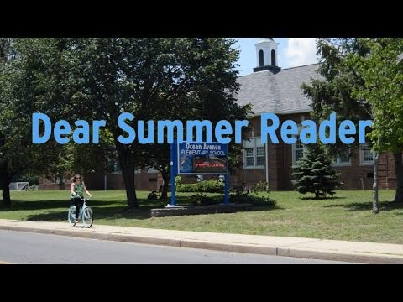
https://www.youtube.com/watch?v=aUGcNKSjaCc

Slide 2

WELL DONE!
The Ofsted inspectors wanted to pass on their thanks to all the children of St Mary’s.
They complimented you on your behaviour, manners and enthusiasm.
We are all very proud of you!

Slide 3

2017
Are you up for the challenge?

Slide 4
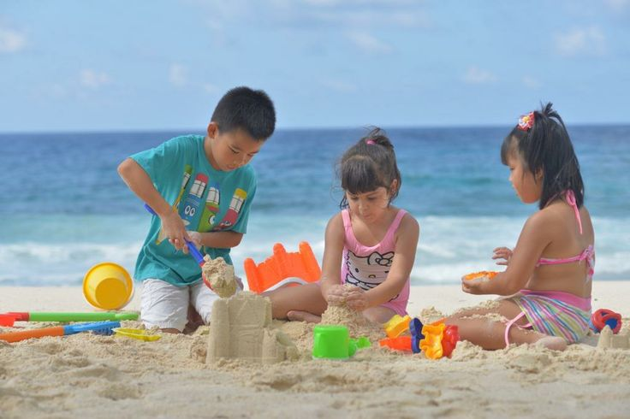
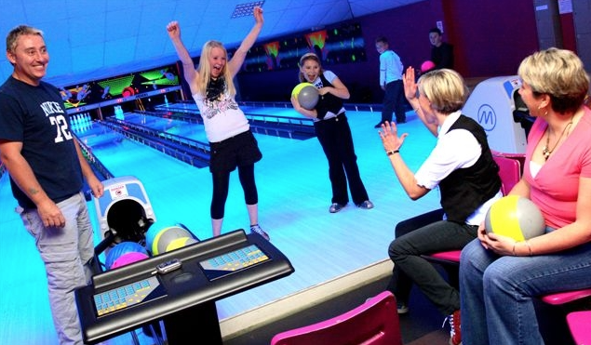
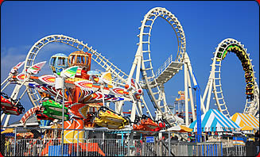
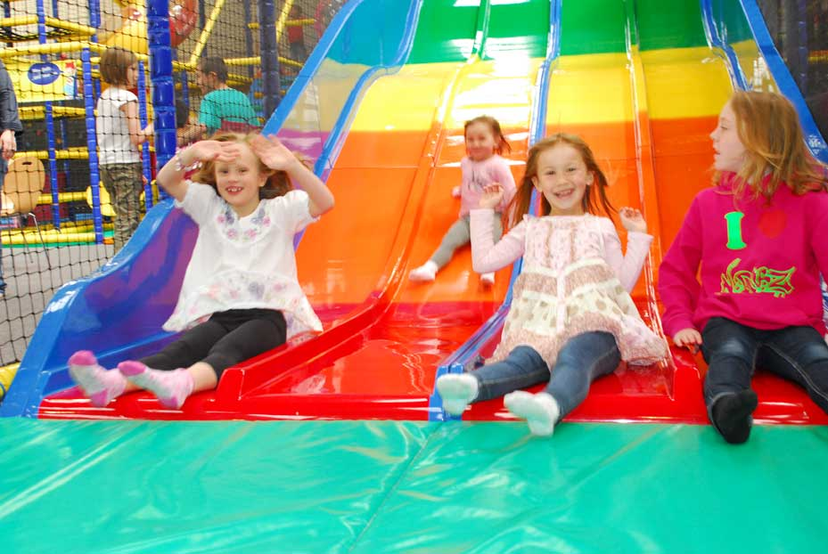
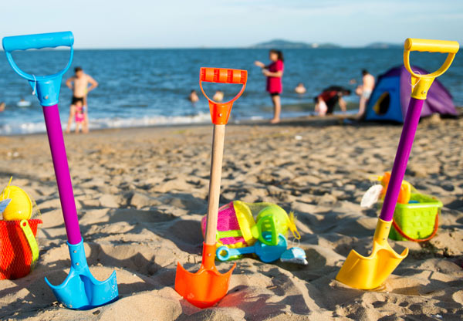
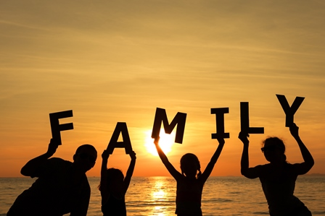
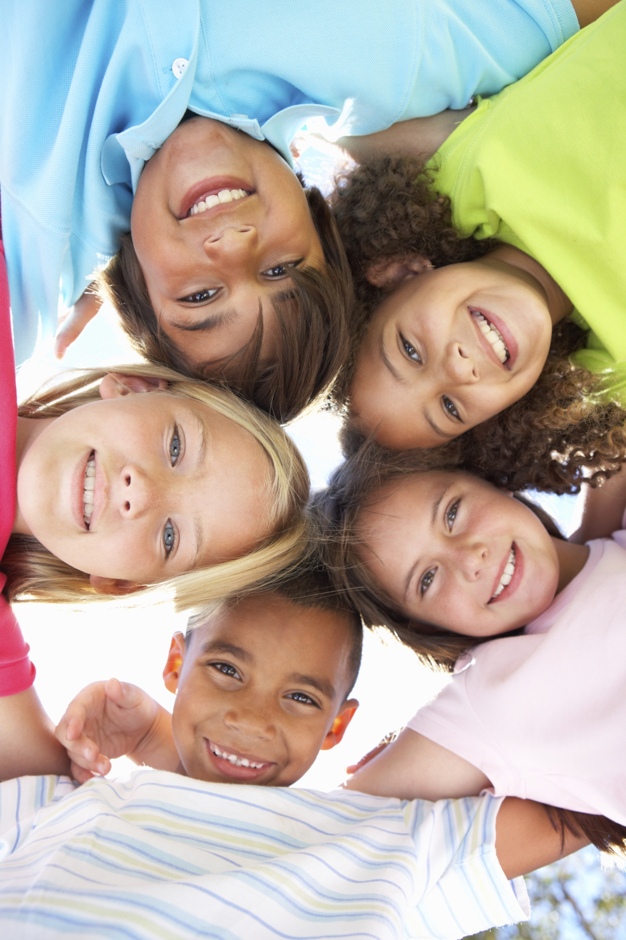
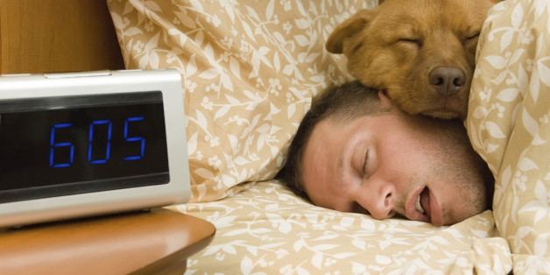
Summer holidays are approaching we will all enjoy:
Days out
Holidays
Lazy mornings
Friends & family

Slide 5

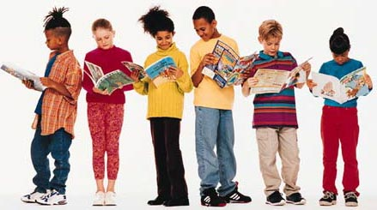

and reading a book, comic, magazine, IPAD or kindle.
https://summerreadingchallenge.org.uk/join-in

Slide 6

Last year we came third.
This year we want to come first!
Library visits will start at the beginning of July, so you can sign up and choose your first three books.

Slide 7
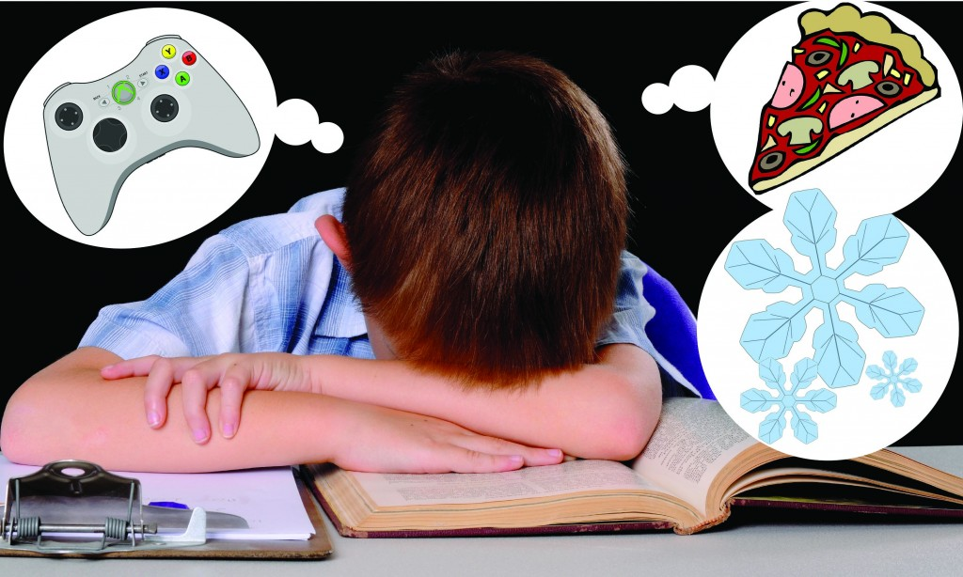
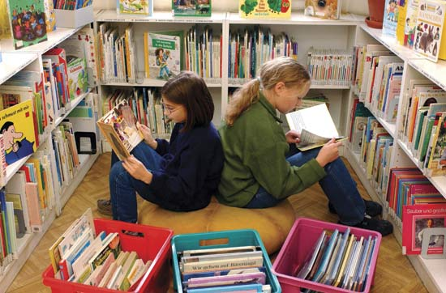
The fiction section of the library will be extended over the next two weeks. This means that it will start on the left hand side of the library, near the window.
So if you wonder where all the books have gone, check on both sides.
Reluctant Readers
Look out for the books with the blue dot.
There is a range of non-fiction, graphic novels and illustrated fiction.

Slide 8
Book Amnesty
Make sure you return any school library books by the end of term.

Slide 9
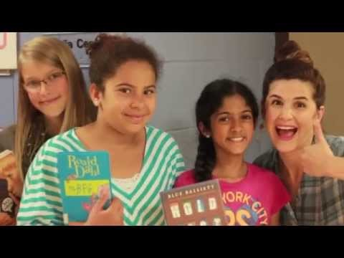
https://www.youtube.com/watch?v=Zu27TqiEIDk

Slide 10

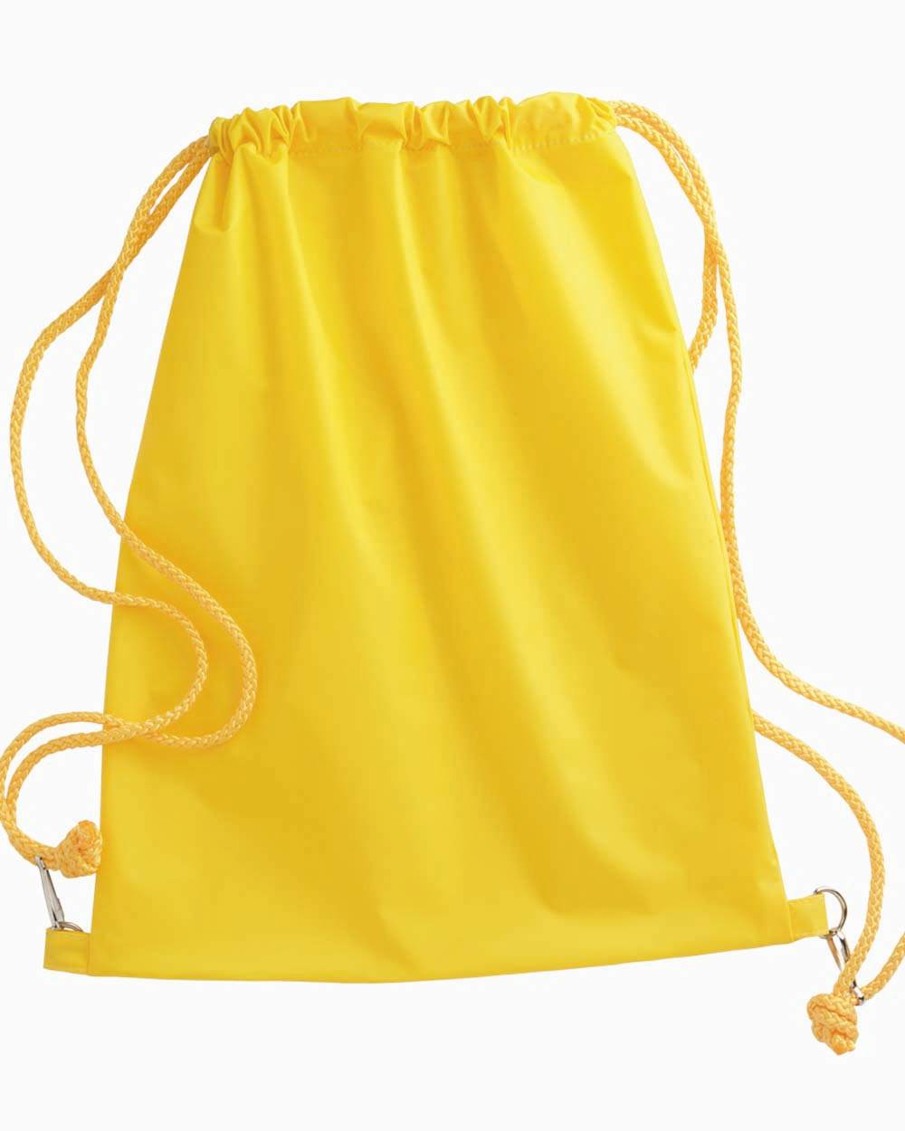

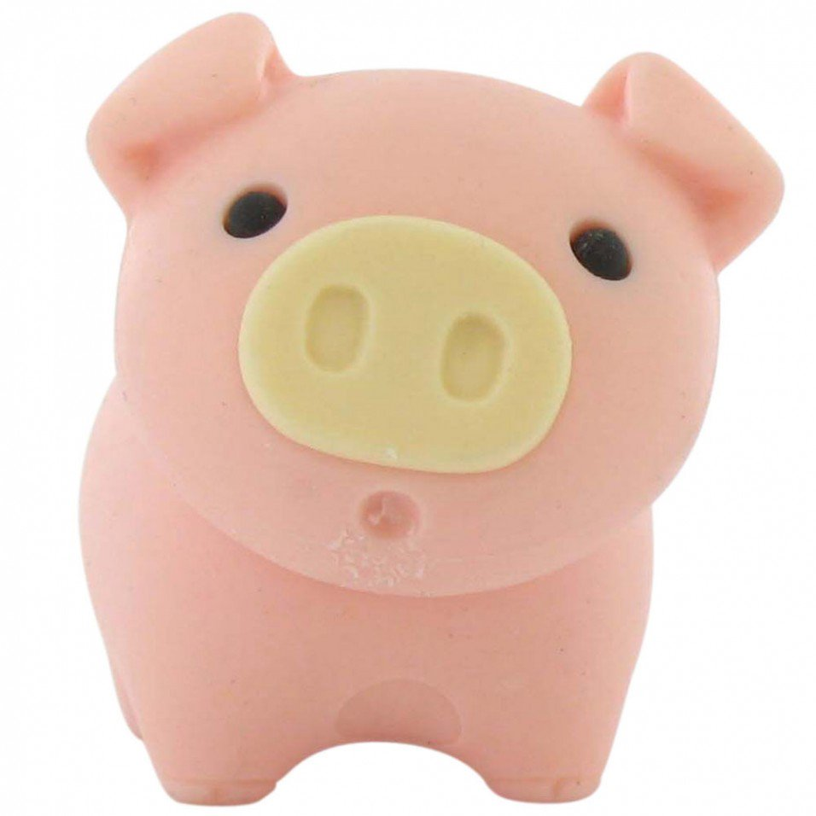





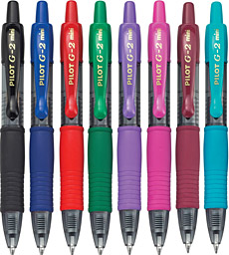
Thursday at 12:15pm

Slide 11

Your library needs

Slide 12

Story Writing Competition
Let’s introduce the organisers

