Slide 1


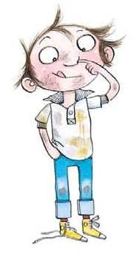

Slide 2

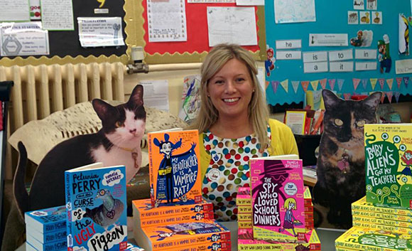
Pamela Butchart

Slide 3
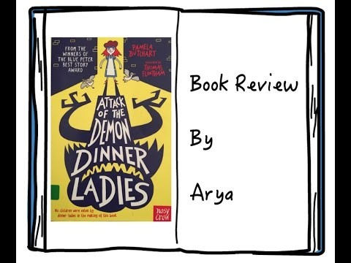

Slide 4



Phil Earle

Slide 5




Ultimate
Football Heroes

Slide 6


Slide 7

No 1 Boy Detective – Barbara Mitchellhill

Slide 8




Geek Girl
by Holly Smale
The Worst Witch by Jill Murphy
Diary of a Wimpy Kid by Jeff Kinney
Coming soon …
Picture book section – look out for my next assembly for more news.

Slide 9


