Slide 1
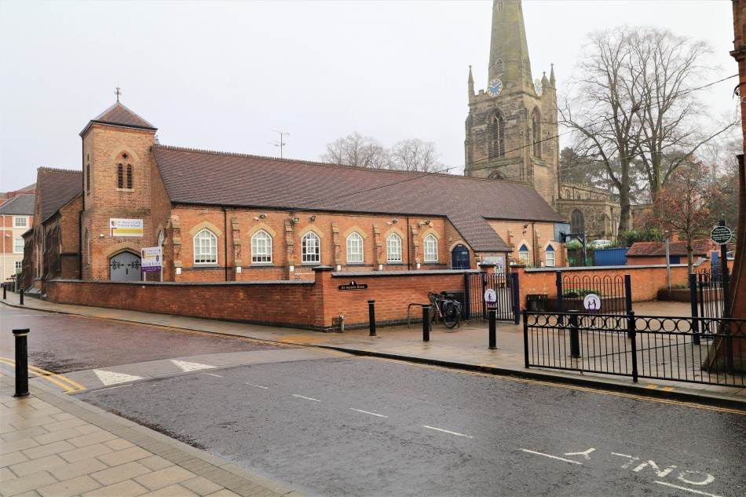
Welcome to St. Mary’s Church of England Primary School

Slide 2
We are the only Church of England Primary School in Hinckley.
We currently have 263 pupils on roll in 10 classes.
Ofsted were extremely positive about our school and Foundation provision in September 2023, when they judged the school to be Good.
‘St Mary’s Primary School is much loved by pupils, parents and carers. Pupils are happy and say that the staff look after them well. The school is a welcoming, caring and positive environment.’
One parent echoed the views of many others when they said, ‘This school is like a home from home for my child: they are so happy here.’

Slide 3
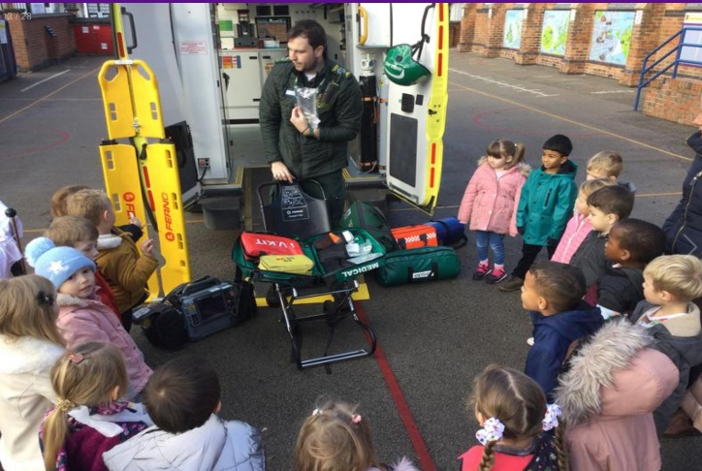
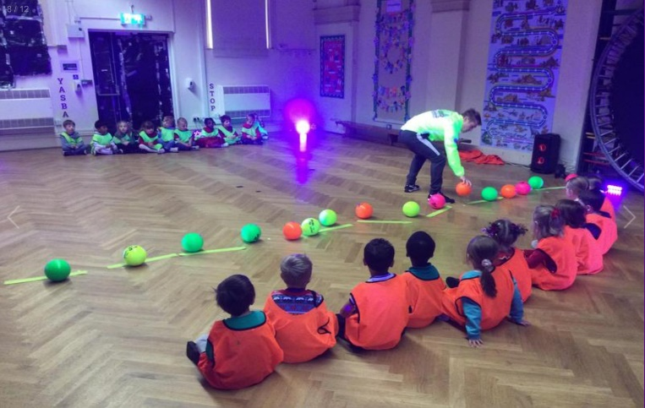
We are really looking forward to welcoming you into our church school family at the start of next academic year. Thank you for choosing us. We won’t let you down! We firmly believe that a strong partnership between home and school is essential in order for your child to achieve their full potential both socially, emotionally and academically. We are looking forward to creating many memories for you and your child over the next seven years.

Slide 4
The Curriculum
The EYFS curriculum is based upon seven areas of learning and development that all early years settings follow.
‘Children in early years enjoy learning a well-structured curriculum that meets their needs and prepares them well for their next steps. They quickly begin to thrive in the rich learning environment.’

Slide 5
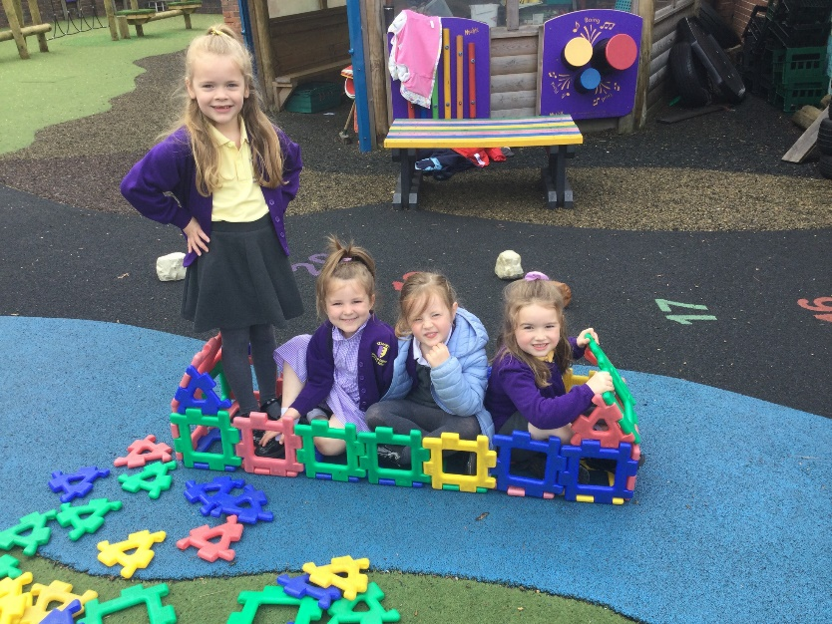
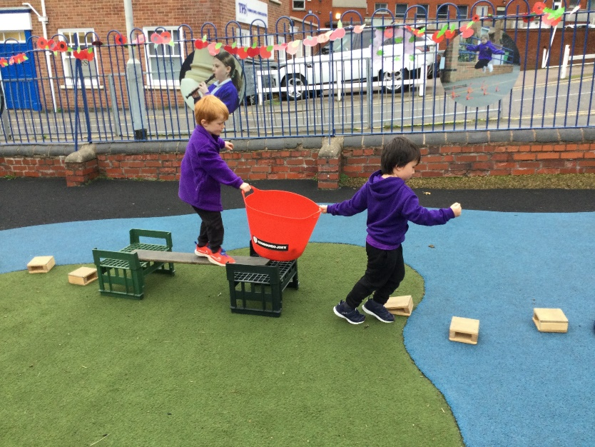
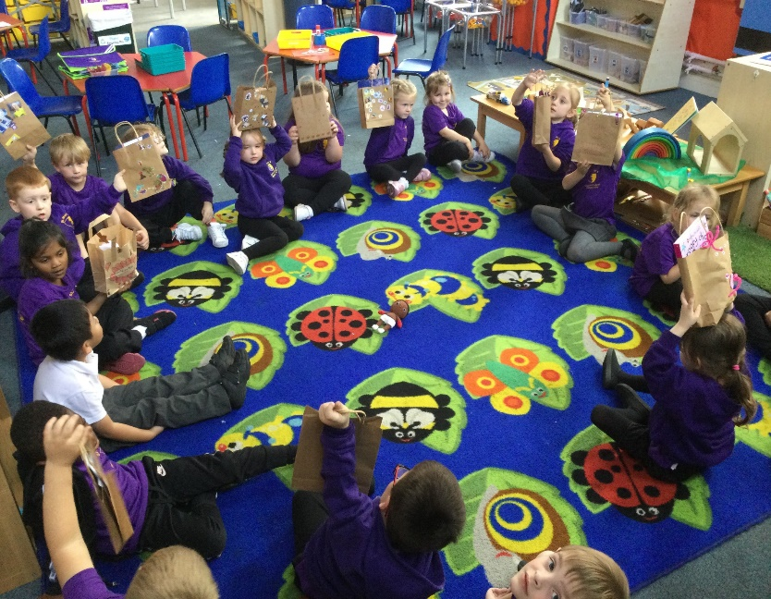
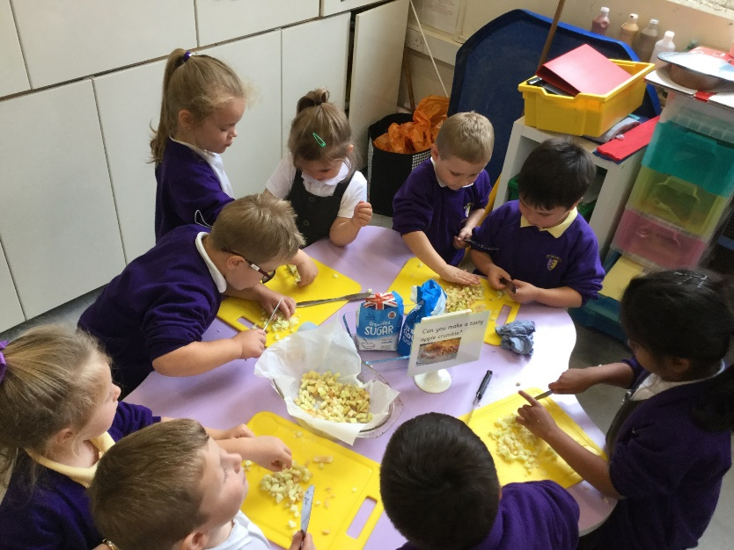
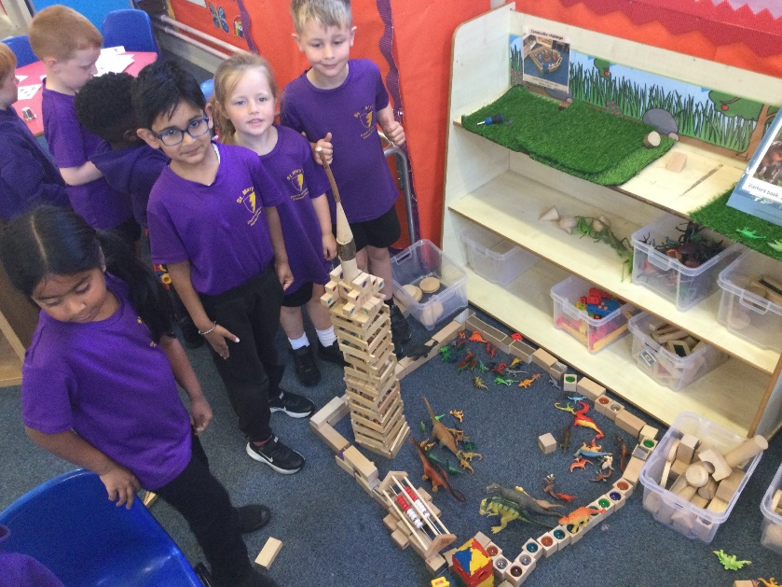
Communication and Language

Slide 6
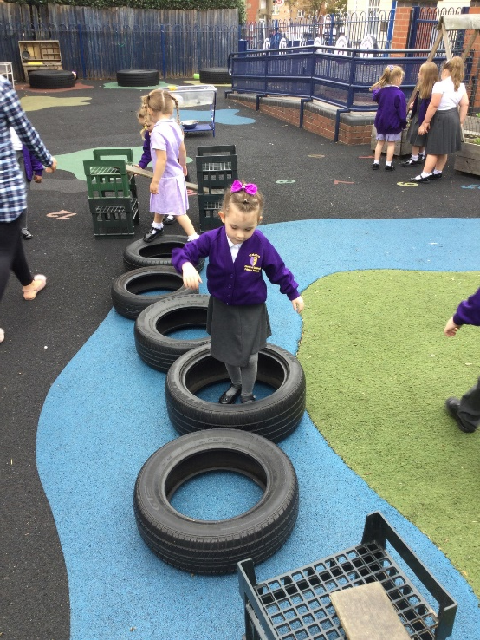
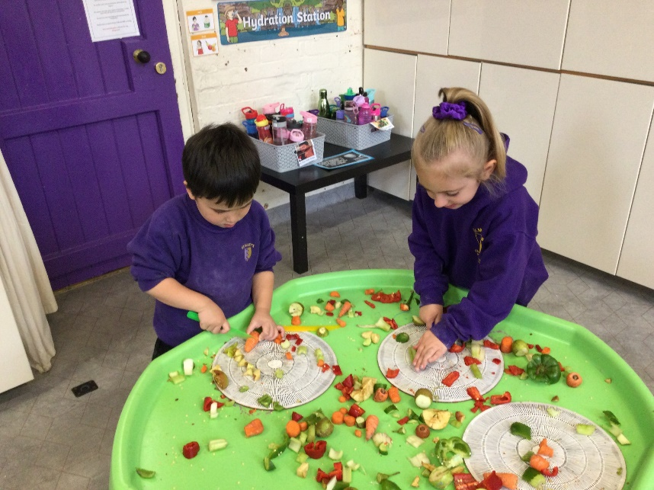
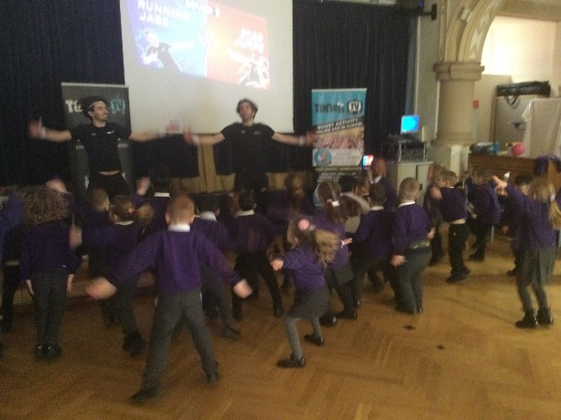
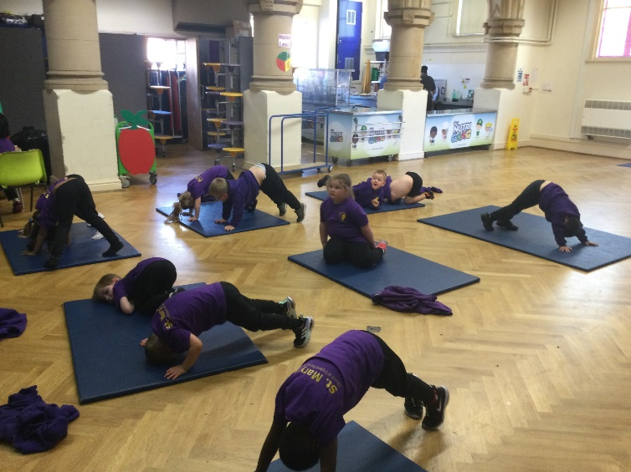
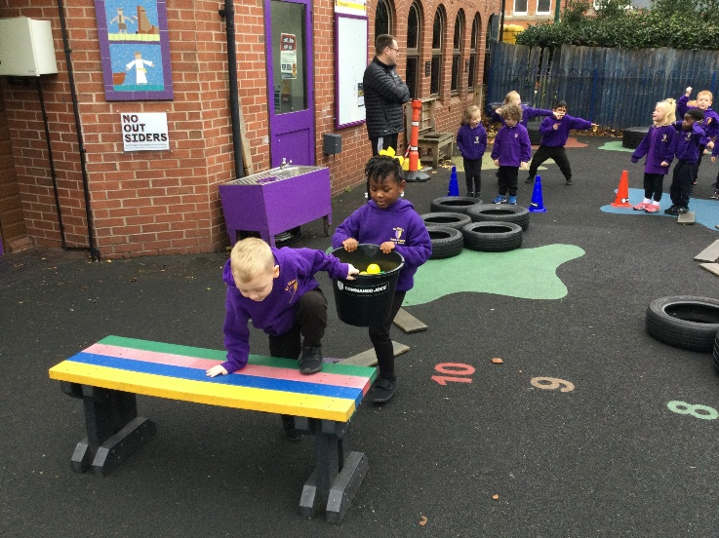
Physical Development

Slide 7
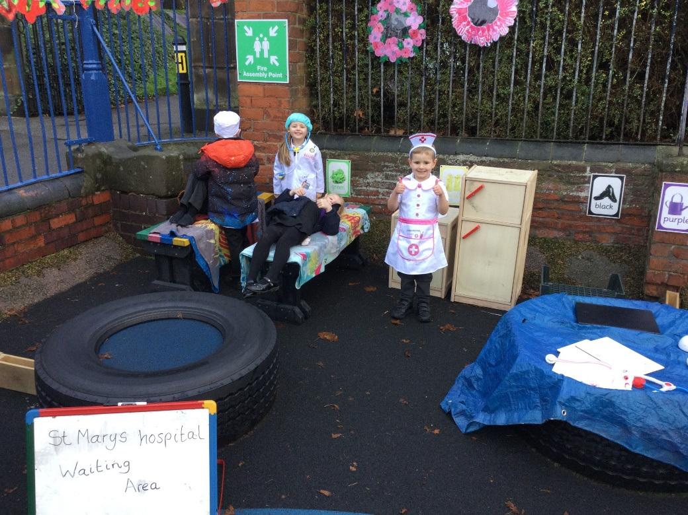
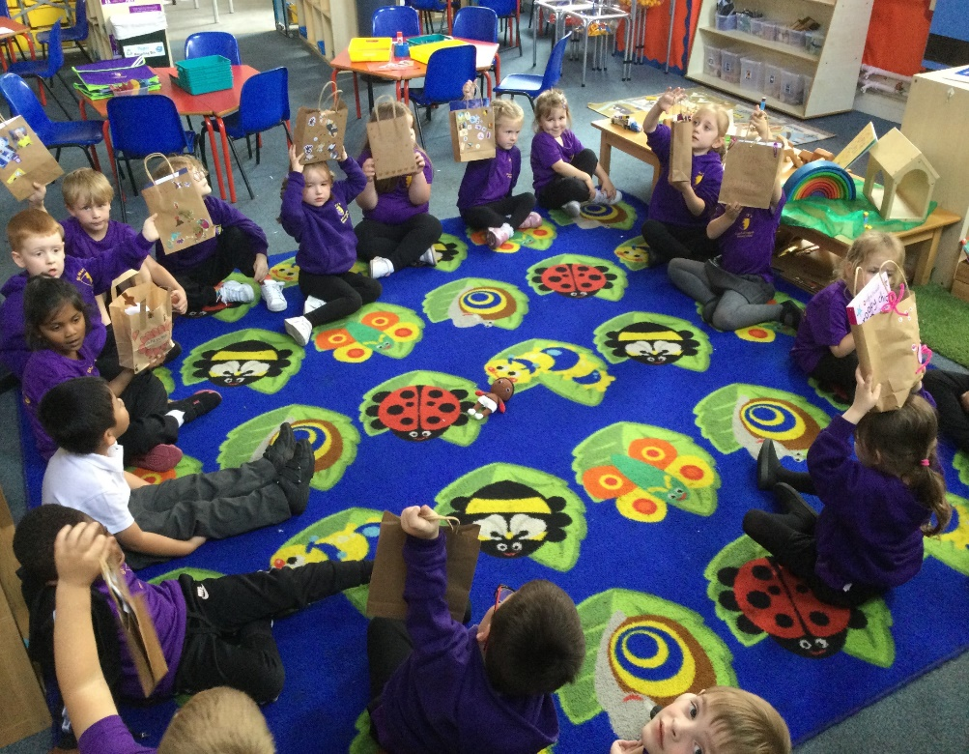
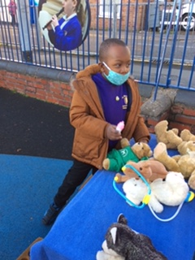


Personal, Social and Emotional Development

Slide 8
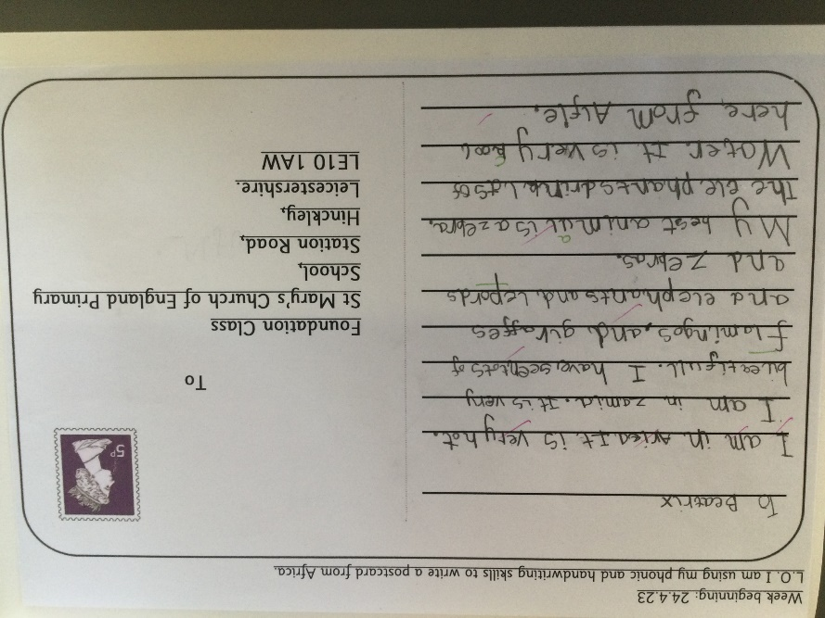
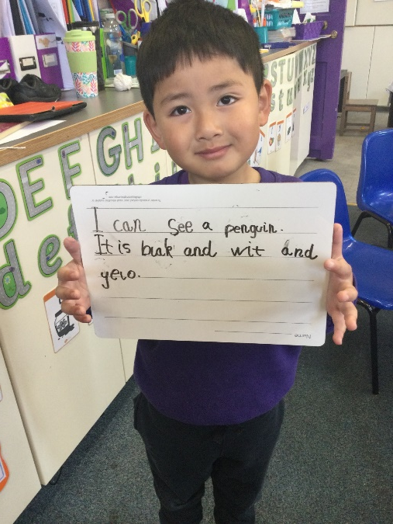
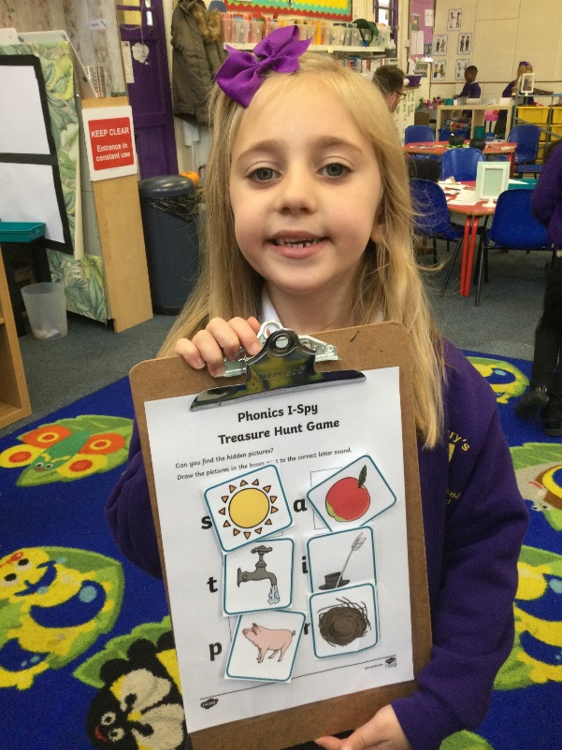
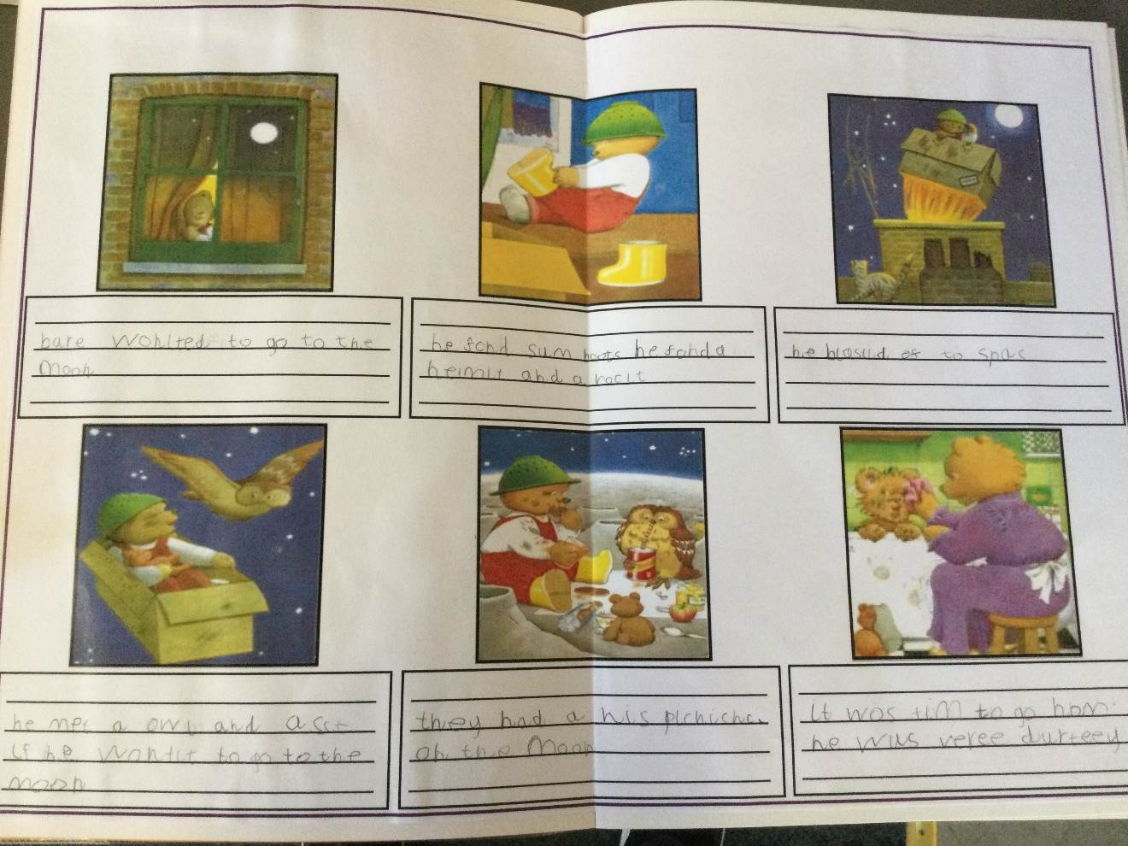
Literacy

Slide 9
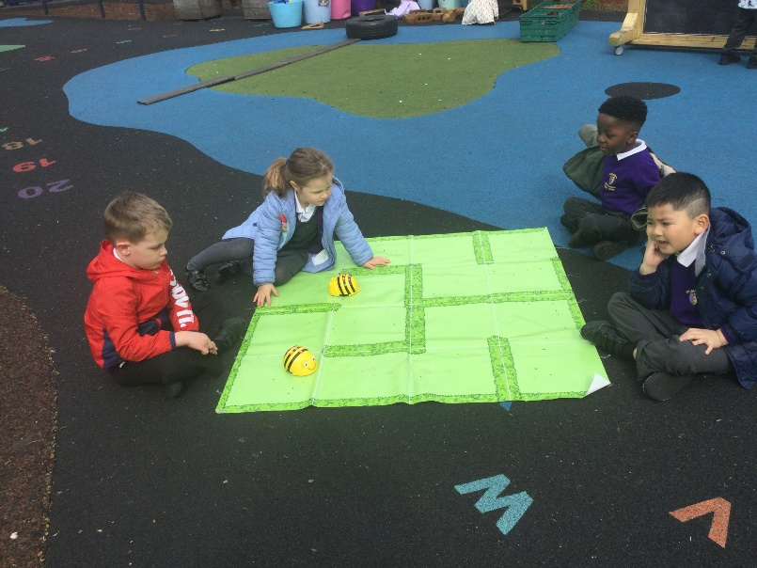
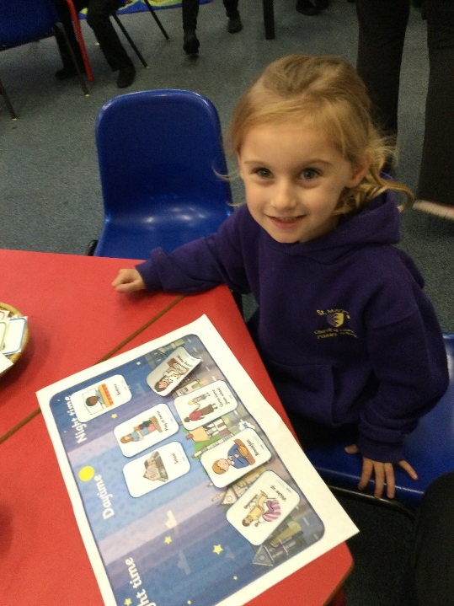
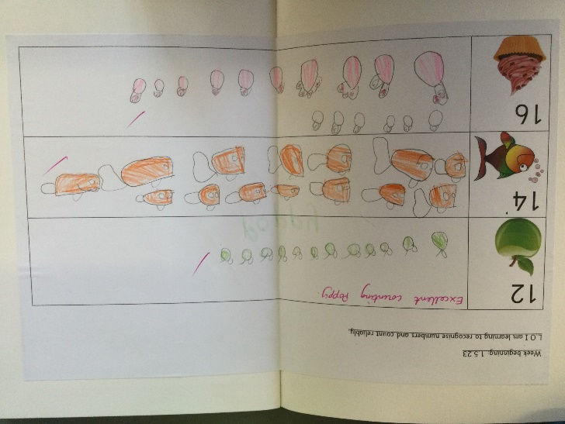
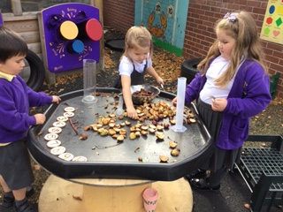
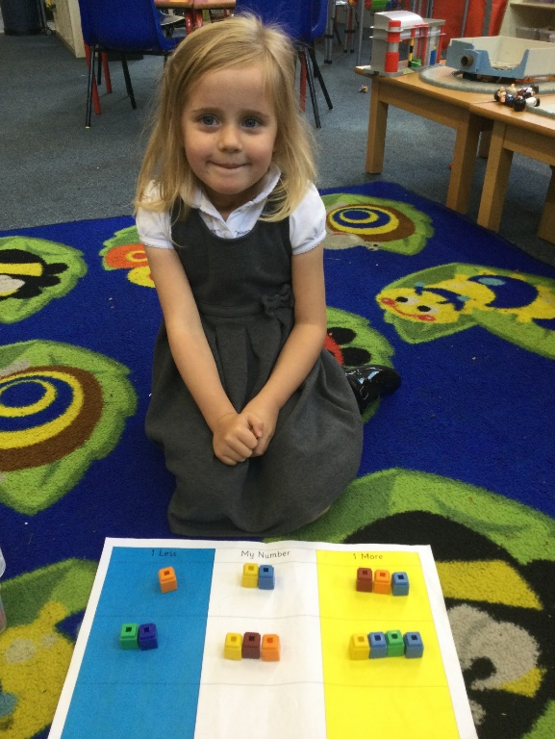
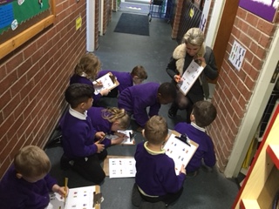
Mathematics

Slide 10
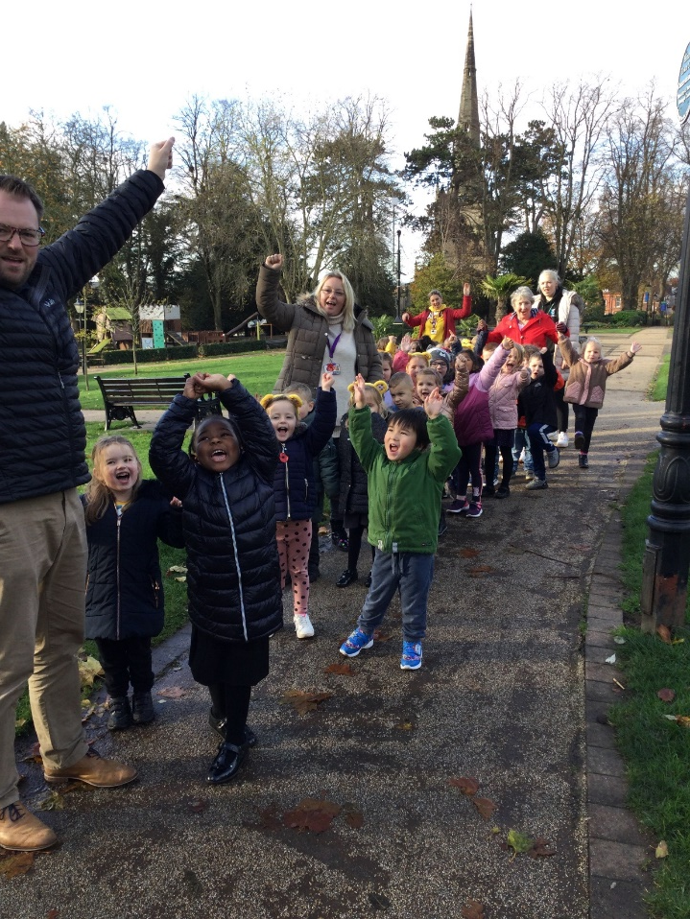
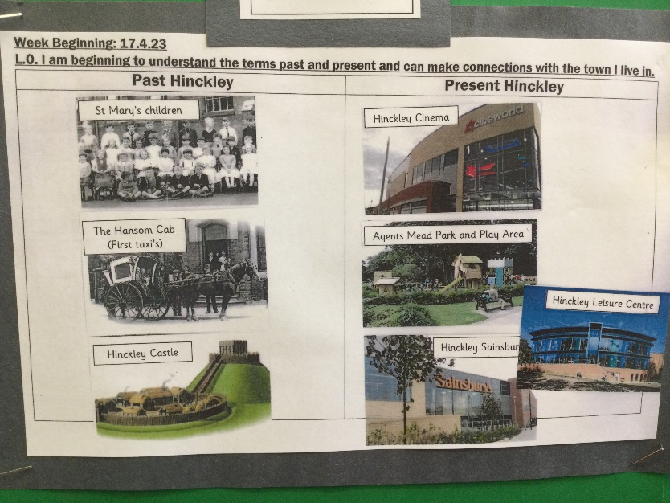
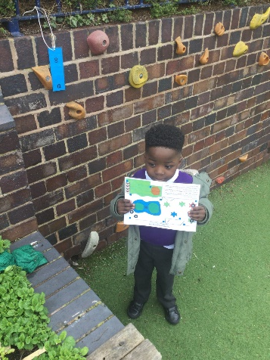
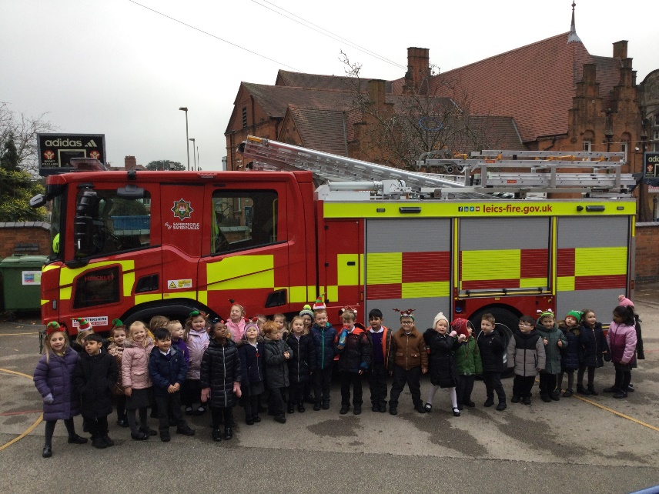
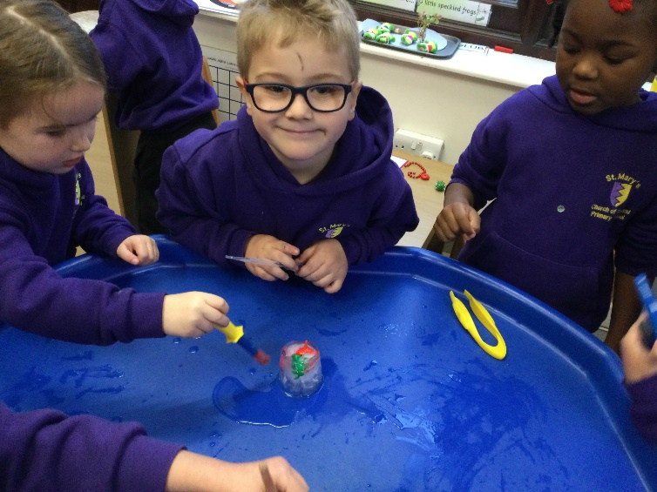
Understanding the world

Slide 11
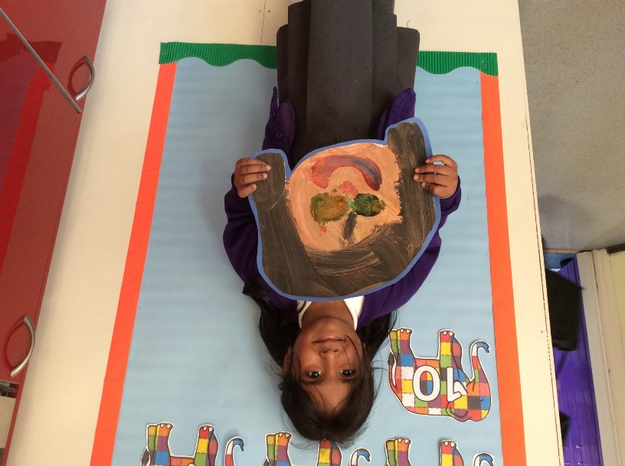
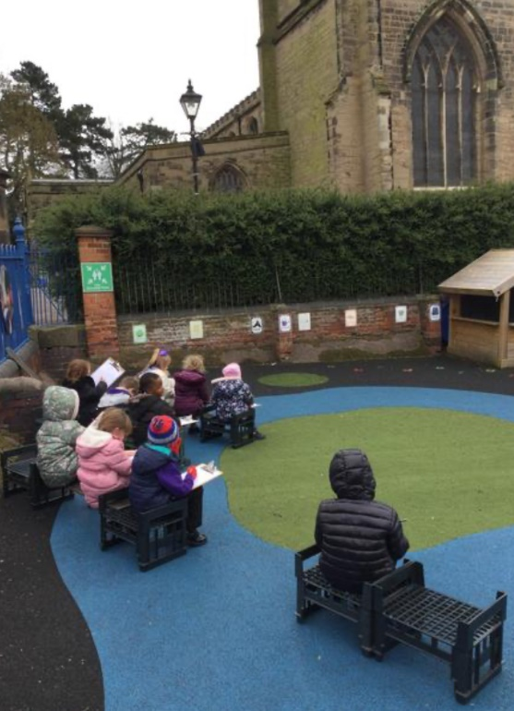
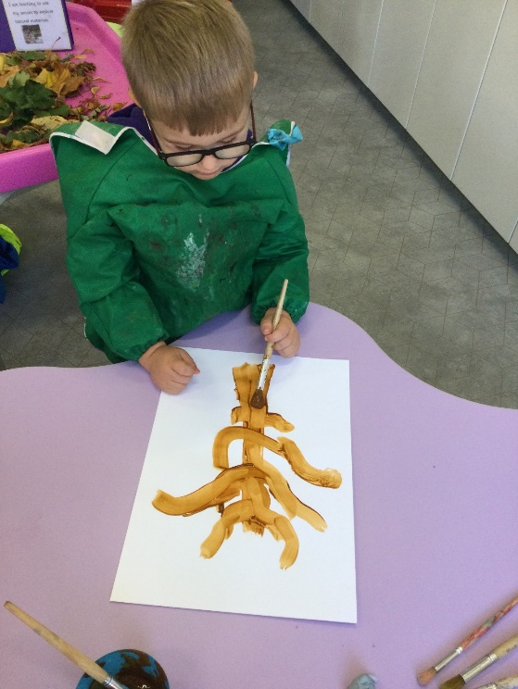
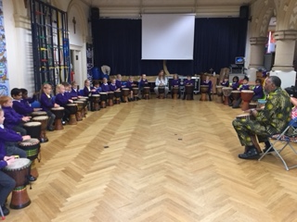
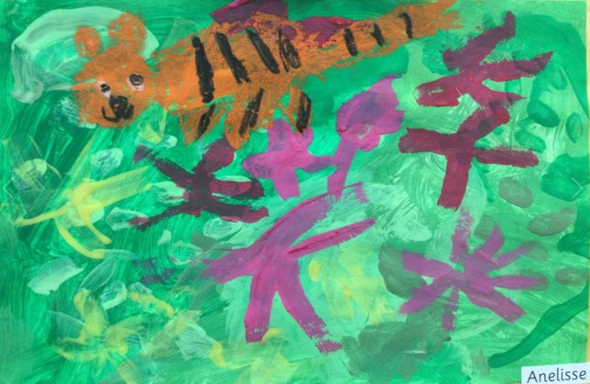
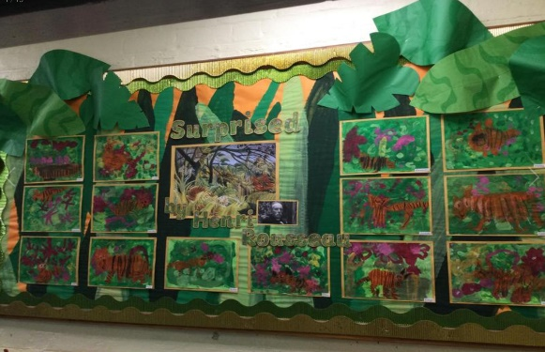
Expressive Arts

Slide 12
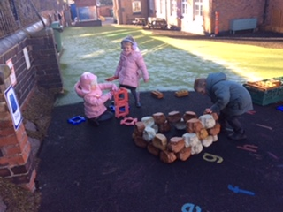
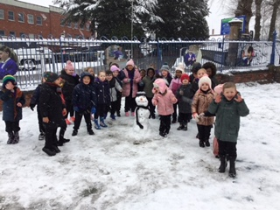
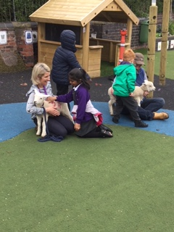
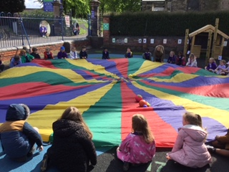
Learning indoors and out!
Our curriculum is a very active one both indoors and out. We learn outside whatever the weather!

Slide 13

Learning Outside
Please ensure your child brings appropriate clothing all year round, especially during the Winter.
In Summer provide your child with a sun-hat and apply sun-cream before they come to school.

Slide 14
Attendance and Safety
Please ring the school office if your child is poorly and cannot attend school.
Please ensure that your child is punctual- School starts at 8.40a.m and finishes at 3.15p.m.
If your child is being collected by someone other than yourself please let a member of staff know when you drop your child off. This person must have a password which is known to us. For obvious safety reasons your child will not be allowed home with someone else if we have not been informed.

Slide 15
Meet the teacher
On Wednesday 26th June, we will be running our ‘Meet the Teacher’ sessions. You will meet with either Mrs Corley or Mrs Jenkinson. Please bring your child with you.
This meeting is your opportunity to chat on a one to one basis about your child. This meeting will last around 15 minutes.
Mrs Burrows will also be in the Unit during this time.

Slide 16
Induction Sessions: Stay and play
Following the meet the teacher appointment, your child is invited into Foundation for a stay and play session on Thursday 4th July.
Your child will be in either Group A or Group B.
Group 1 will attend from 9.15am to 10.15am.
Group 2 will attend from 10.30am to 11.30am.
This session will allow your child to play to play alongside others who will be in their peer group.
Mrs Perkins, our Family Support Worker will provide tea/coffee for parents whilst their children are in the Unit.

Slide 17
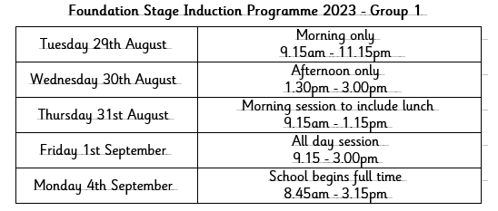
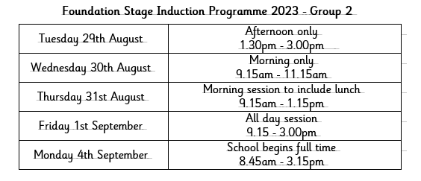
Induction in after the summer break For our induction purposes your child will either be in group one or group two. Next week we will inform you of your child’s group.

Slide 18
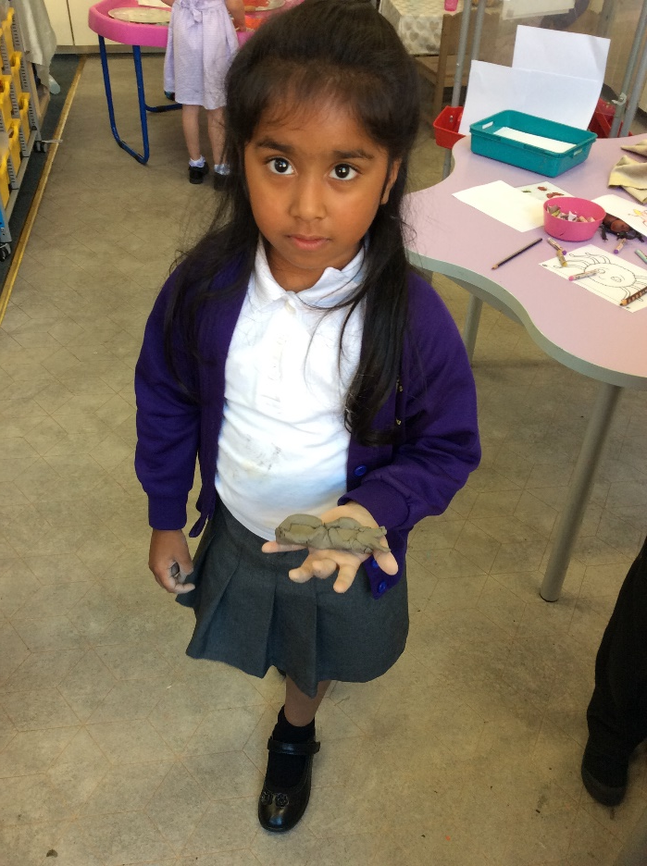
School Uniform
GIRLS
White shirt or white or lemon polo shirt
Black or grey skirt, pinafore dress, trousers or shorts
Purple sweatshirt, cardigan or fleece with school badge
Black/grey/white socks or tights
Black school shoes not trainers
Summer (optional)
White/purple dress
White/yellow dress
Please keep hair accessories to a minimum.

Slide 19
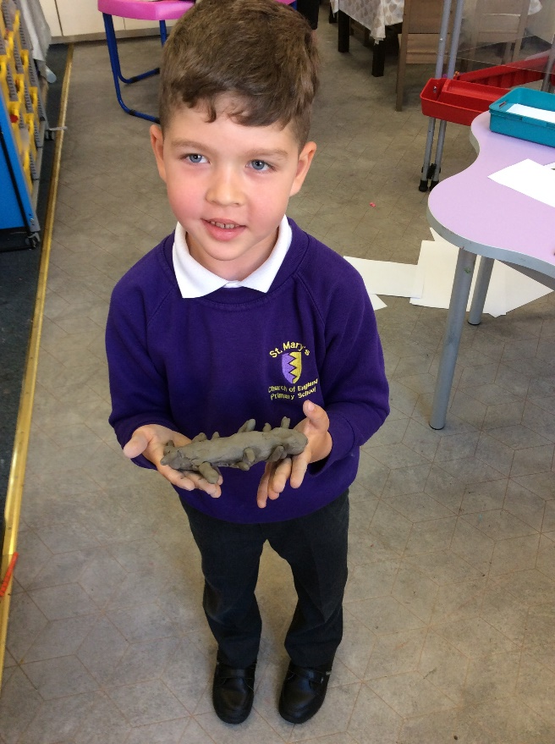
BOYS
White shirt or white or lemon polo shirt
Black or grey trousers or shorts
Purple sweatshirt, cardigan or fleece with school badge
Black/grey/white socks
Black school shoes not trainers

Slide 20
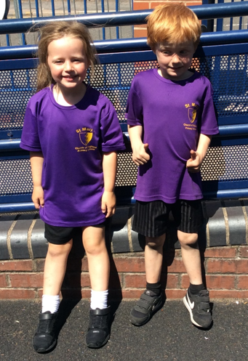
PE
P.E. KIT
Plimsolls or training shoes
Purple Logo T-shirt
Black shorts
Plain black or purple sweatshirt
Plain black jogging bottoms
Drawstring bag
Please ensure that all items are clearly named.

Slide 21

PE
Please ensure that all items are clearly named.
For all PE sessions, for safety reasons, children must remove earrings and watches and both boys and girls with long hair, must tie hair back.
Those children with long hair are encouraged to come to school with their hair tied back to prevent the spread of head lice.
We will inform you our PE days, your child will need to come into school that day wearing their PE kit.

Slide 22
Preparing your child for school
Getting dressed and undressed:
Put on shoes -velcro is best!
Practise fastening a zip.
Put on a school jumper the right way round.
Encourage them to care for themselves when they use the toilet but help is always available. Please provide a bag of spare clothes in a named carrier bag in case of accidents.

Slide 23
Thank you!
We will be happy to answer any questions you may have.

