Slide 1


Welcome to our Year 1 and 2 ‘Meet the teacher’ meeting!

Slide 2
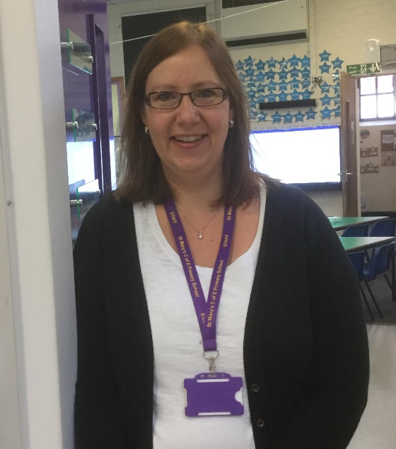
Introducing our Year 1/2 team
Teresa Class
Mrs Mosedale

Slide 3
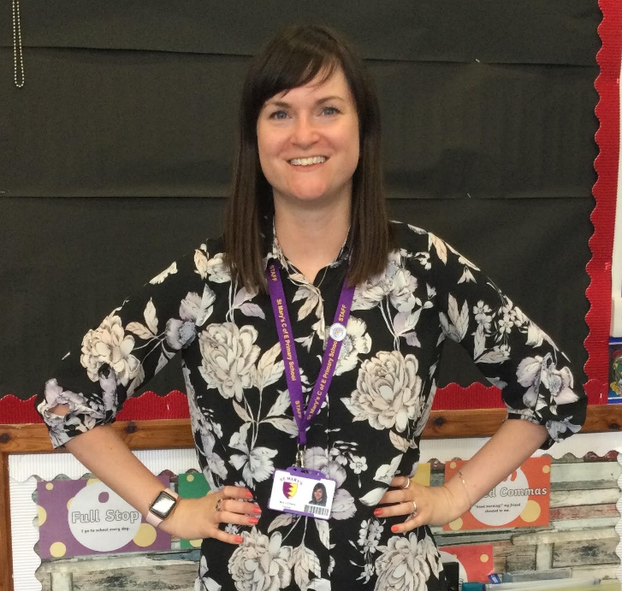
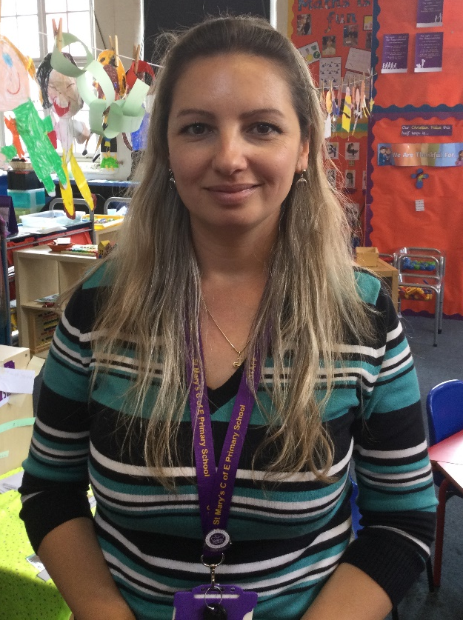
Introducing our Year 1/2 team
Picasso Class
Mrs O’Hara
Mrs Chiroiu

Slide 4
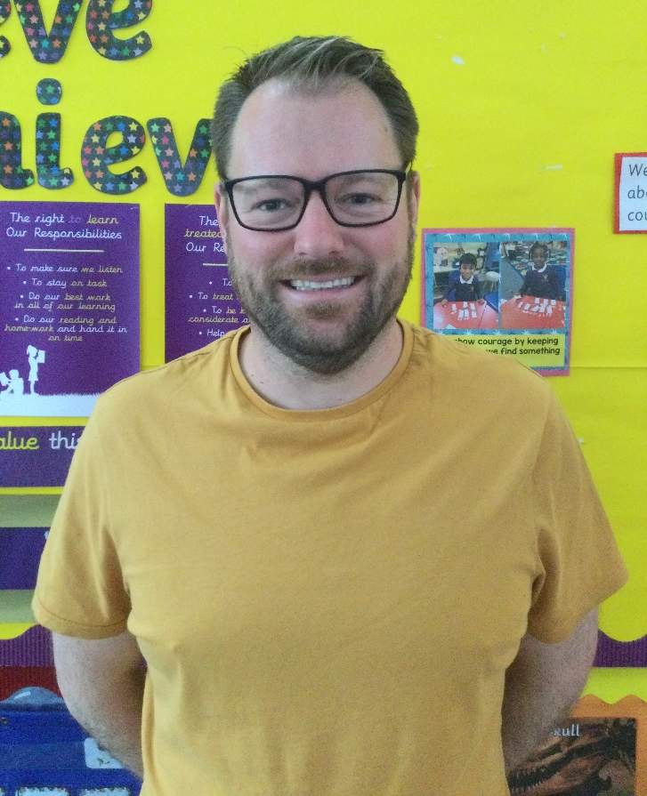
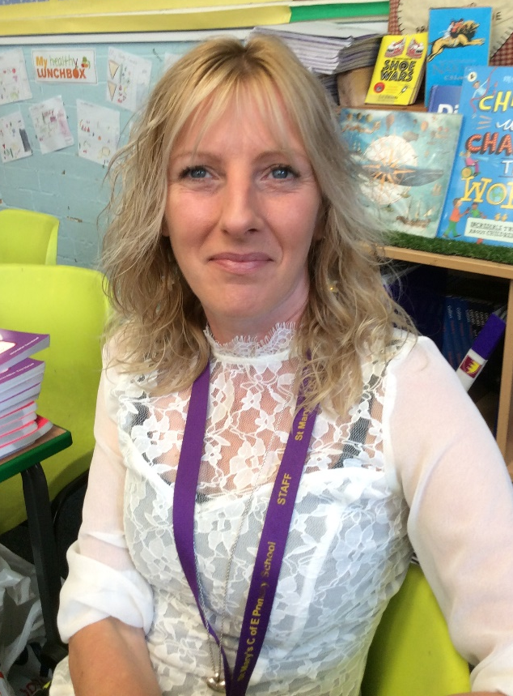
Introducing our Year 1/2 team
Stafford Class
Mr Bond
Mrs Stanley

Slide 5
Today’s meeting
PE
Bags/Lunch boxes
Homework
Topics
Phonics
Phonics/Maths groups
Start of school and home time
Transition

Slide 6
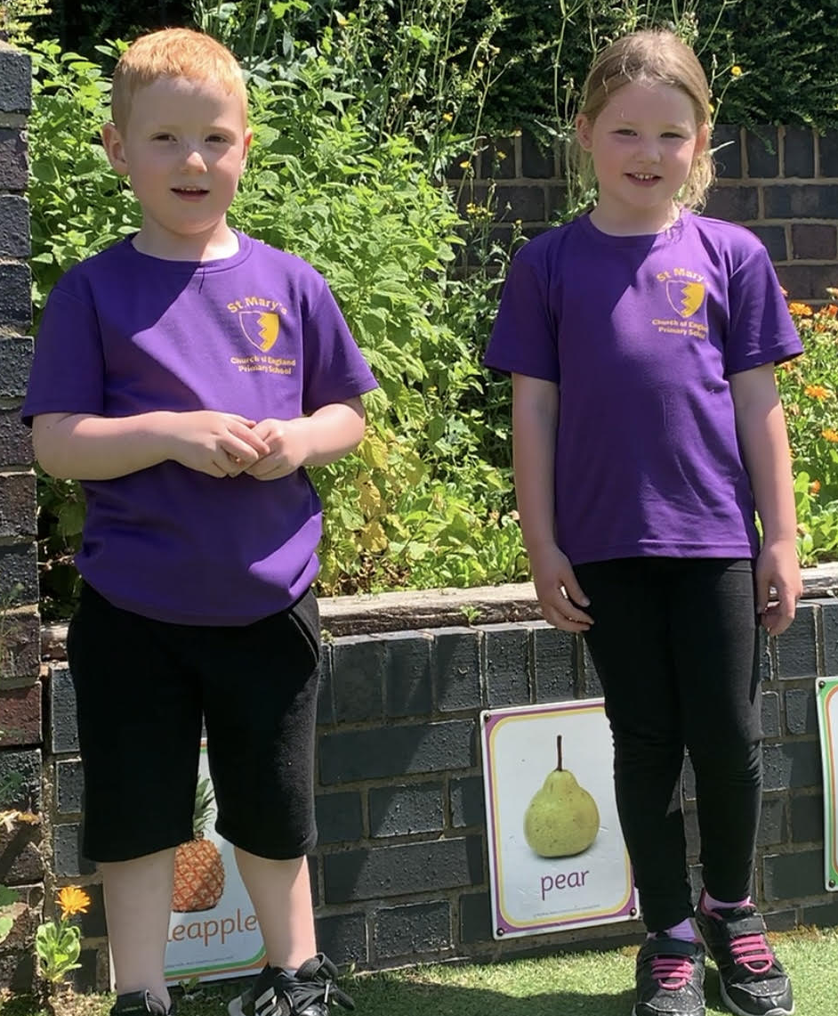
PE
Children will continue to come to school in their PE kit on their PE days.
This should be a purple top and black bottoms.
Hair should be tied up and earrings taken out
on PE days.
PE days for Stafford and Elizabeth classes are Thursday and Friday. Teresa Class will do PE on Tuesday and Thursday.

Slide 7
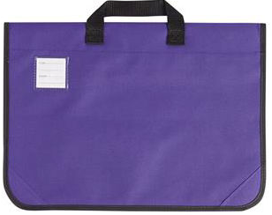

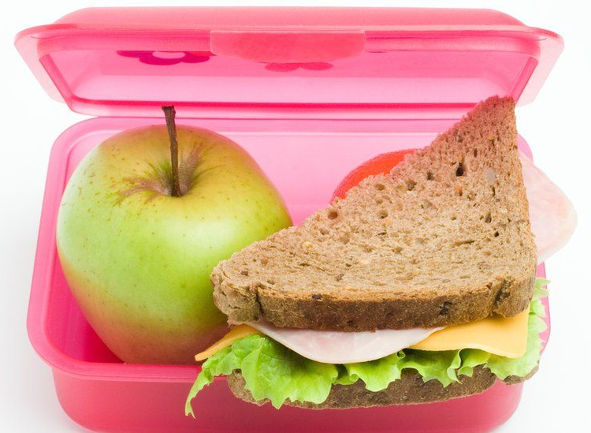
Bags/Lunch boxes
Children will continue to use their purple school book bags. If the children need to bring another bag for any reason, please speak to your child’s class teacher. If they have a lunch box, please label it clearly with their name. We encourage all children to bring in a named water bottle every day.

Slide 8
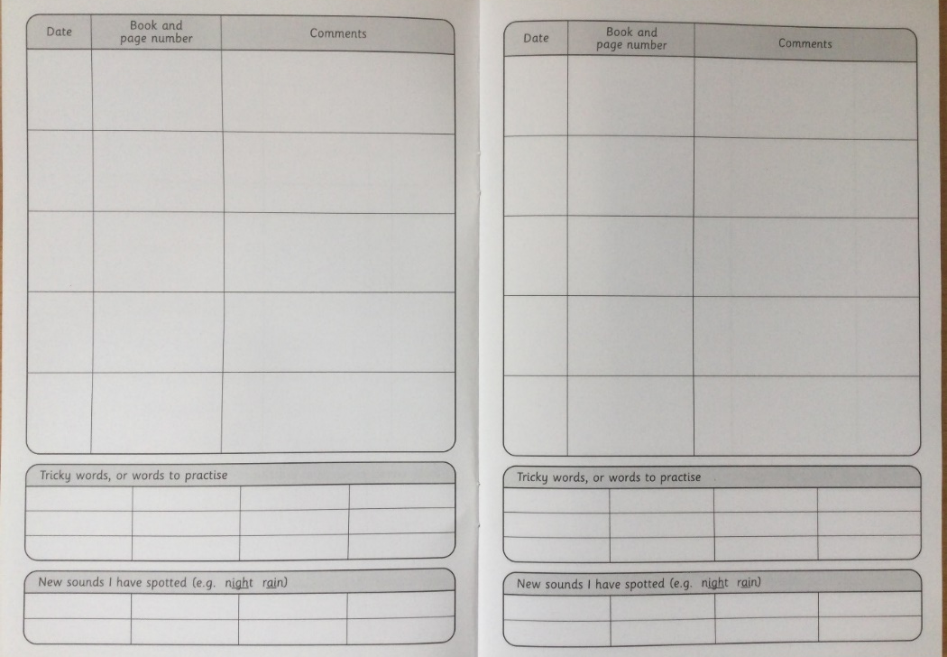
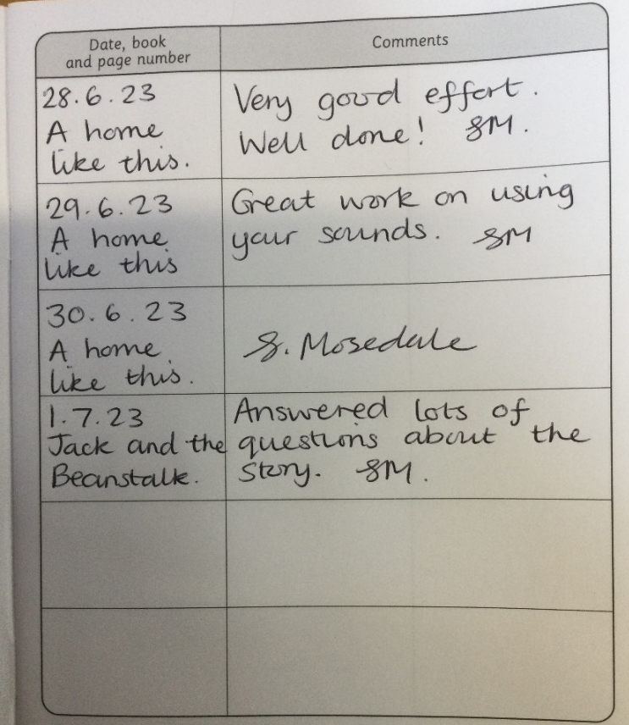
Homework - Reading
Children are expected to read to an adult at home at least 5 times a week. This is to ensure that they continue to make good progress. Please date and sign your child’s reading record. If the children do not do 5 reads, they will do some extra reading practise during Friday playtime.

Slide 9
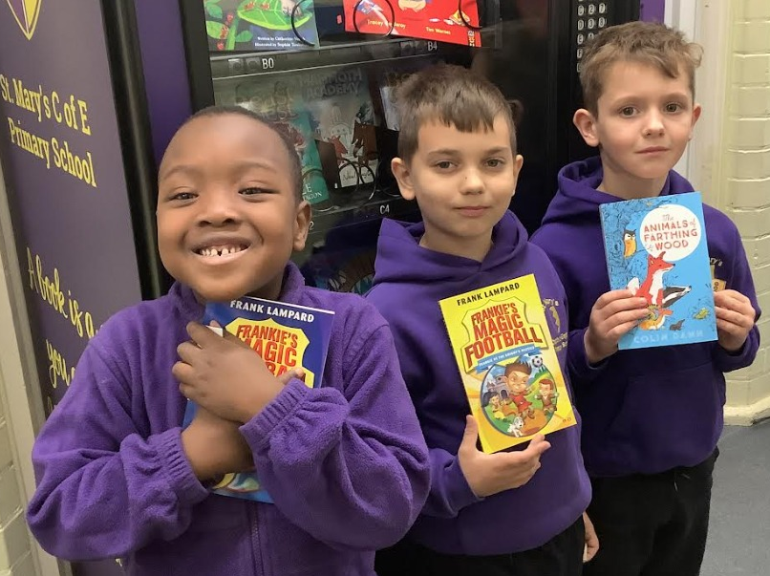
Homework - Reading
If children read at home 5 or more times during the week, they will receive a Golden Ticket. We then hold a draw every Friday afternoon. If their ticket is drawn, they will be able to choose a book from our vending machine.

Slide 10
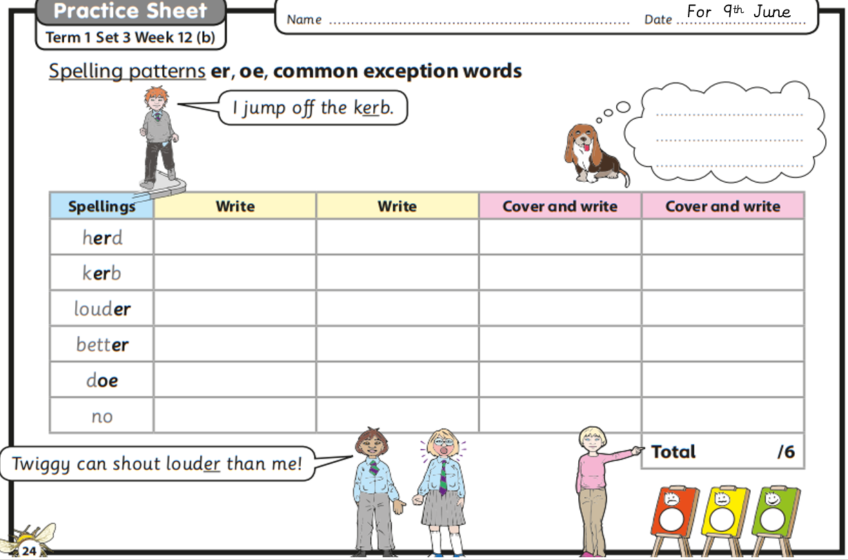
Homework - Spelling
Year 2 children will be given a weekly list of spellings to practise. They will be expected to complete the spelling sheet provided. A spelling test will take place every Thursday. If they don’t complete their spelling practise, they will complete it during Friday playtime. The children will then be given a new list to take home every Friday.

Slide 11
Homework - Spelling
Year 1 children will be given Spelling lists after October half term. To begin with, they will concentrate on their Phonics and reading.
There is also a set of Year 1 and Year 2 Common Exception Words to practise which will be in their Reading Records.

Slide 12
Topics
Our topics are usually based on the History or Geography topic that we are focussing on each half term.
When we have settled the children in, our first topic is History-based and is called ‘Toys – Past and Present’.
After the October half term, we will be looking at ‘At the farm’ which is Geography-based.

Slide 13
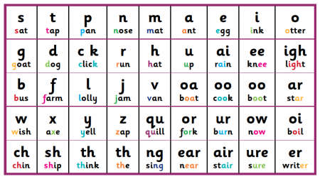
Phonics
In Year 1 and 2, we continue to teach Phonics to all children every day. By October half term, all Year 1 children will be given a Phonics Pack so that they can practise at home. Short, regular bursts of Phonics practise at home will really help your child to progress.
Year 1 children will be expected to take the Phonics Screening Check in June 2025. More information regarding the checks will be provided in the children’s Phonics Packs and we will hold a meeting in the Autumn Term.

Slide 14
Phonics/Maths groups
After we have settled the children in at the beginning of next term, we will teach Phonics and Maths in ability groups. This is so we can really focus on the needs of the children and teach at a pace suited to them. This means that the children may be taught by different teachers in the Year 1/2 team for these lessons.
Teaching Assistants will also be assigned to different groups in order to support the children.

Slide 15
Start of school and home time
All Year 1 and 2 classes come into school via the gate on Station Road.
Children in Picasso and Teresa class will enter and exit via the Bell Tower door.
Stafford class enter and exit via the middle door on to the playground.
We start lining up at 8.40am so that we can make a prompt start at 8.45am. The school day finishes at 3.15pm and the children will go out the same way they came in. Please come to the Station Road side of the playground to collect your child.

Slide 16
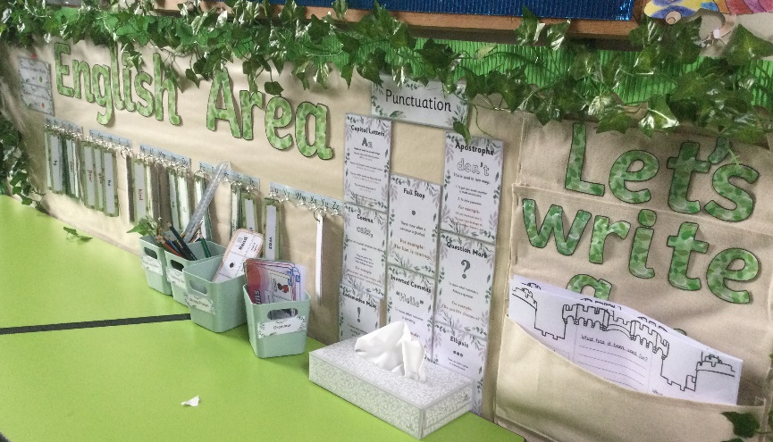
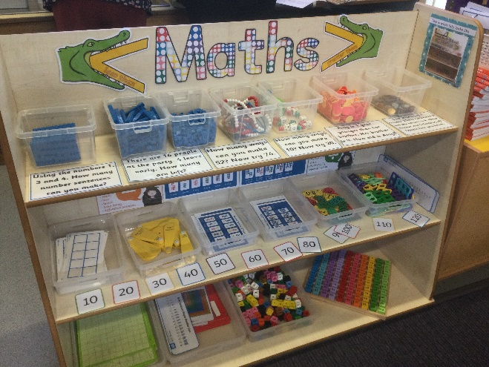
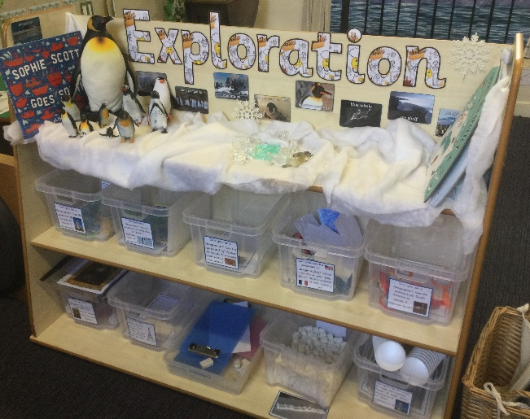
Transition from FS to Year 1
It is very important to us that the children settle in well and enjoy coming to school. We will try our best to make the transition from FS to Year 1 as smooth as possible. We will have similar routines in the mornings so that the children know exactly what to do when they come in. We also have areas around our classrooms, similar to FS, for children to explore and learn through play. For example, we have a construction area, cutting area, and art and craft activities as well as English, Maths and Exploration areas.

Slide 17
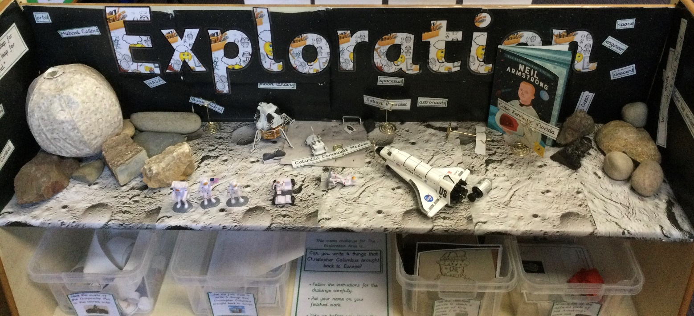
Transition from Year 1 to Year 2
We now know the current Year 1 children very well and will be able to extend their learning further as well as giving them the support they need.
As they move into Year 2, we will promote more independence and we find that they are usually very good at helping the Year 1 children settle in.

Slide 18
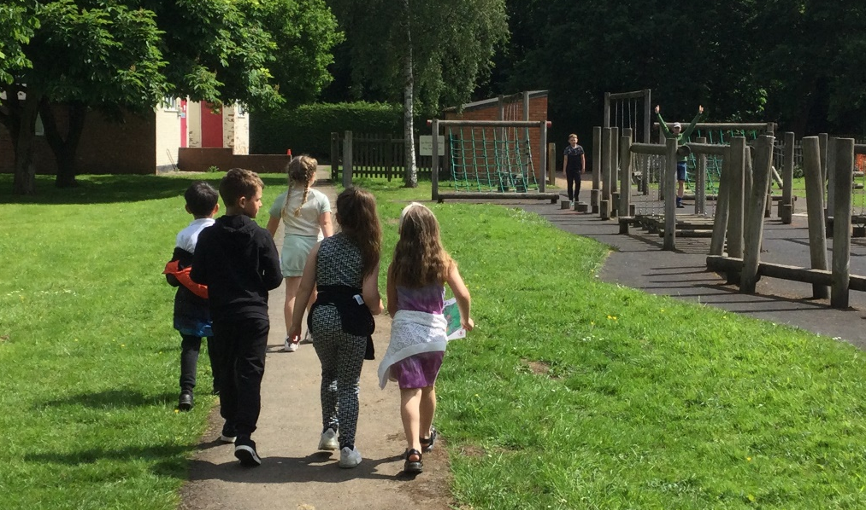
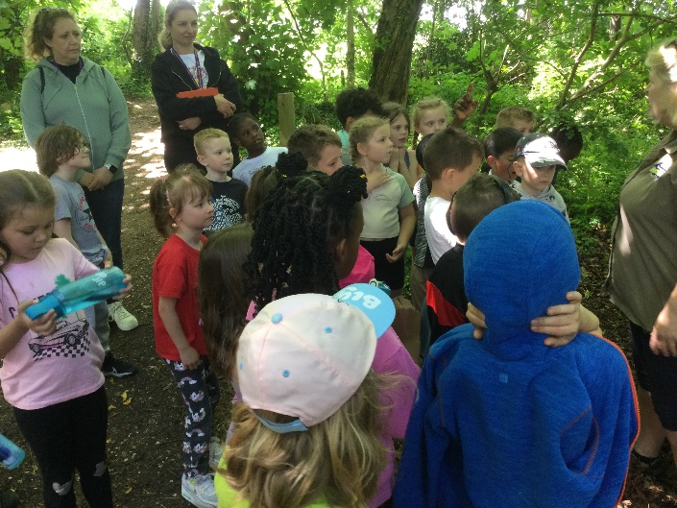
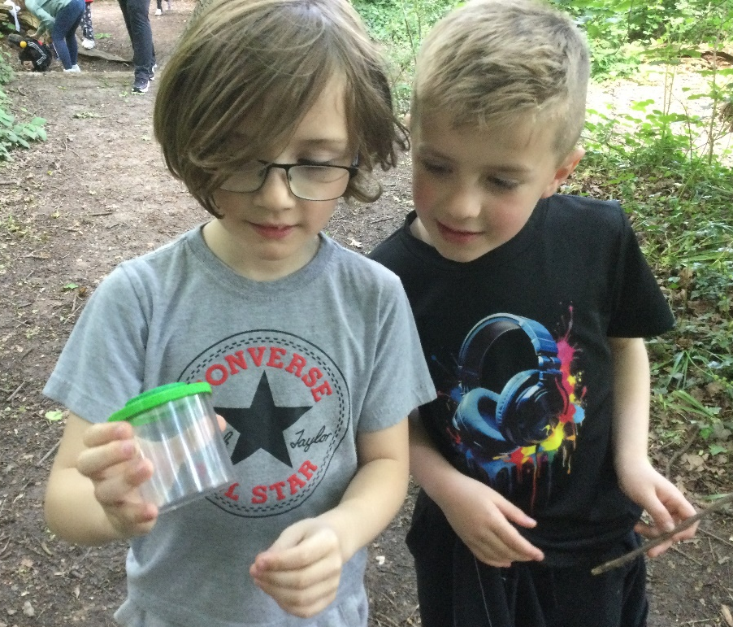
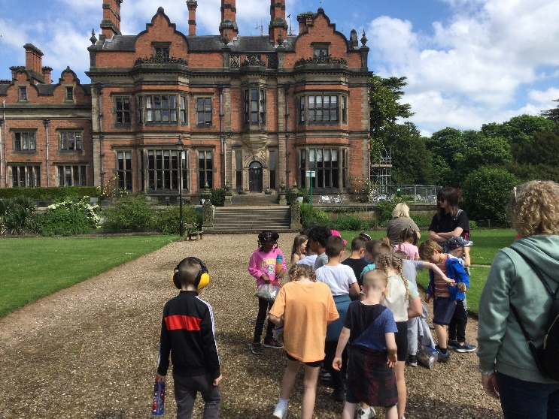
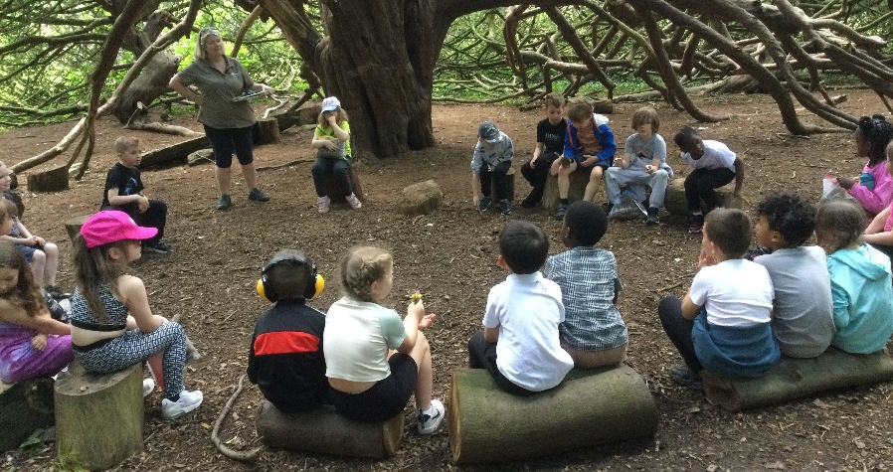
We will have lots of fun!
We look forward to welcoming your children into our classes on Friday afternoon and after the Summer holiday. Here is a little taster of some of the fun activities we have taken part in this year.

Slide 19
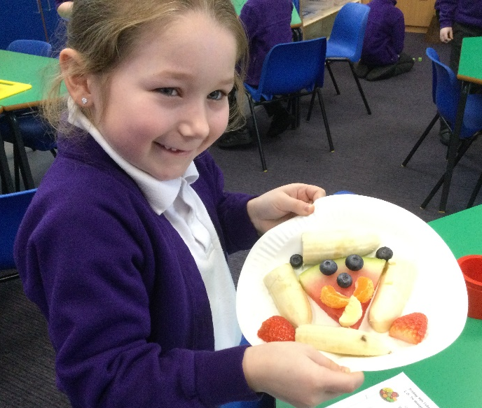
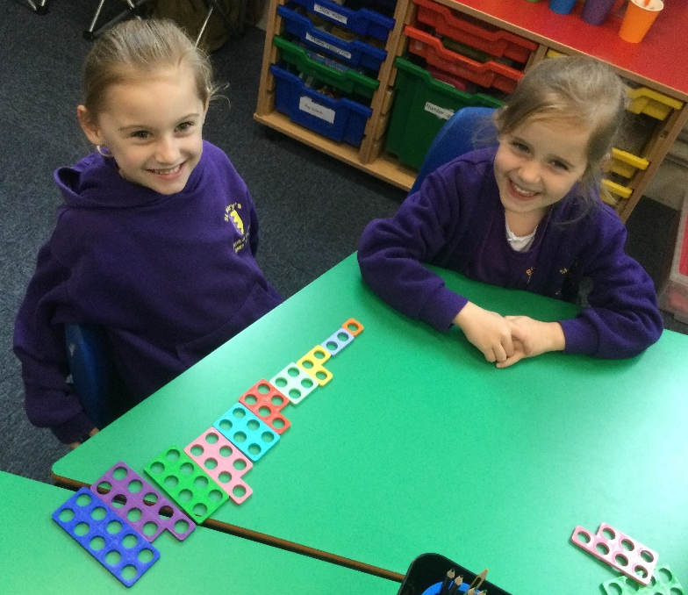
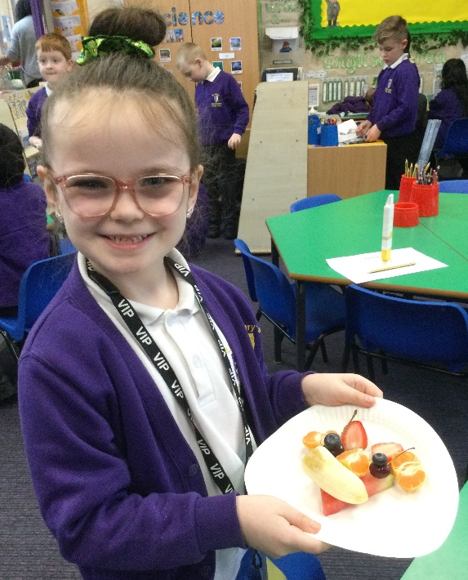
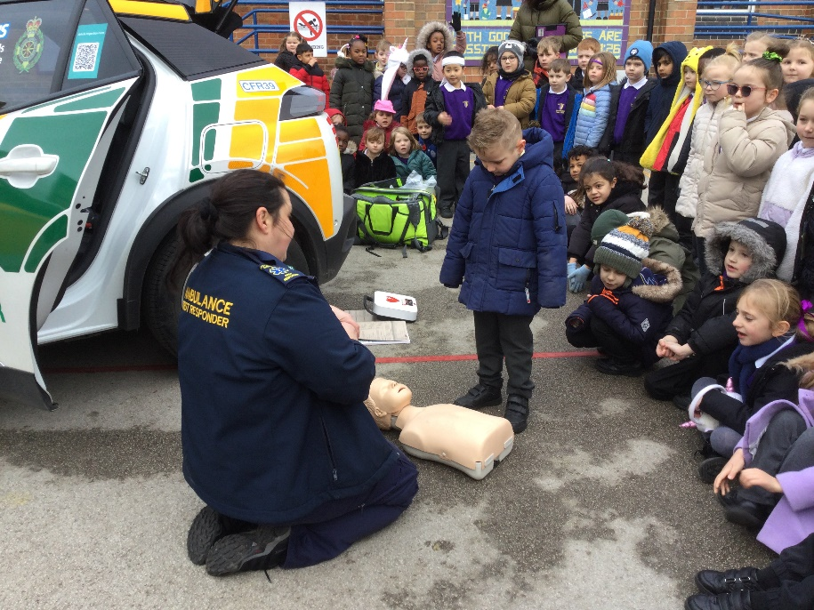
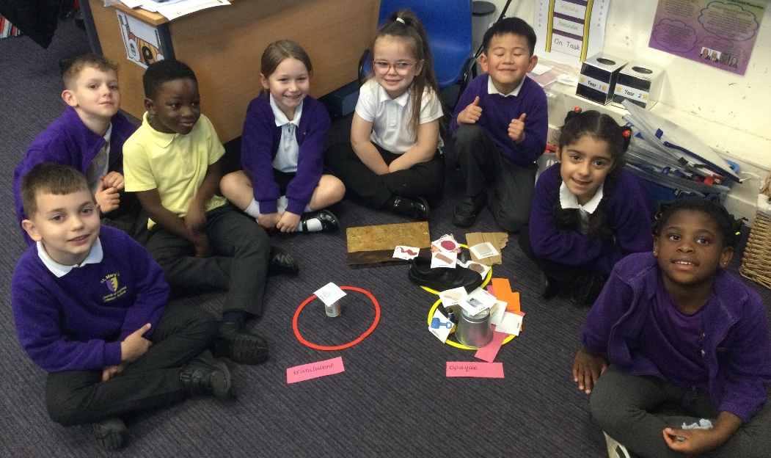
We will have lots of fun!

Slide 20
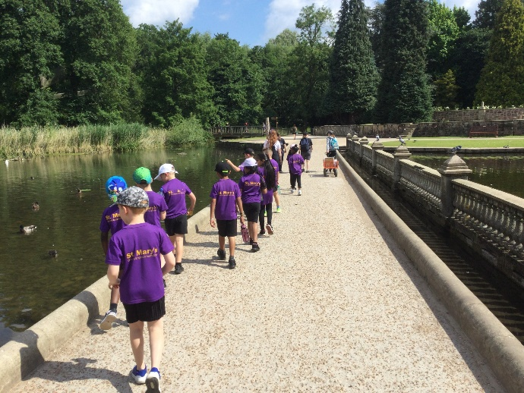
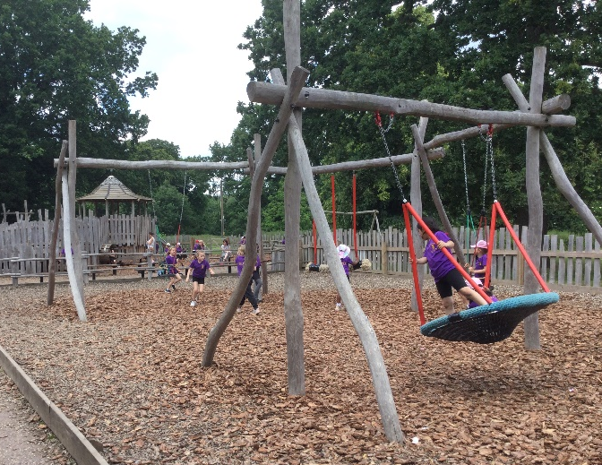
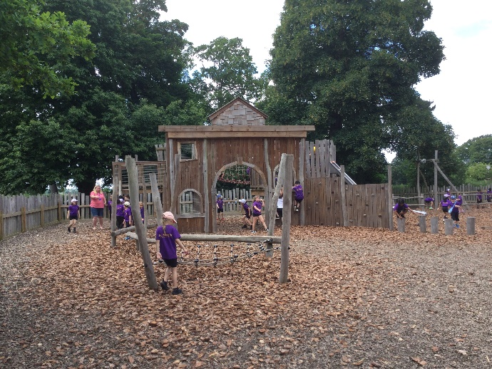
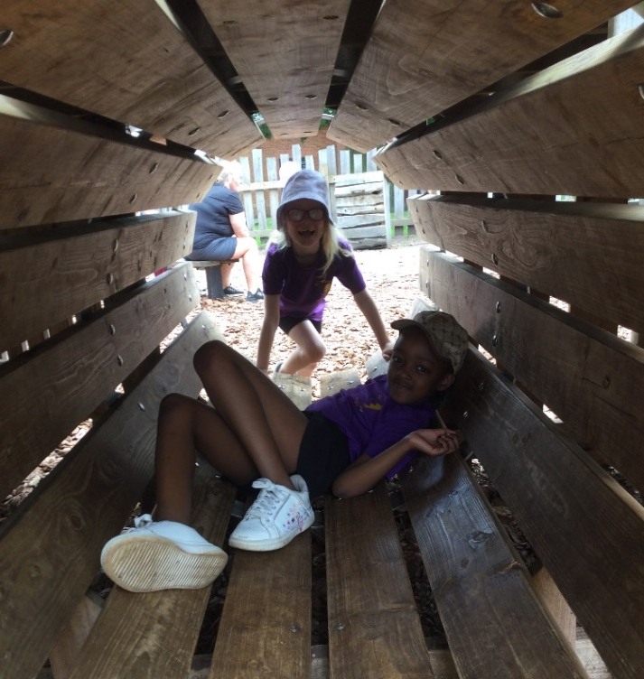
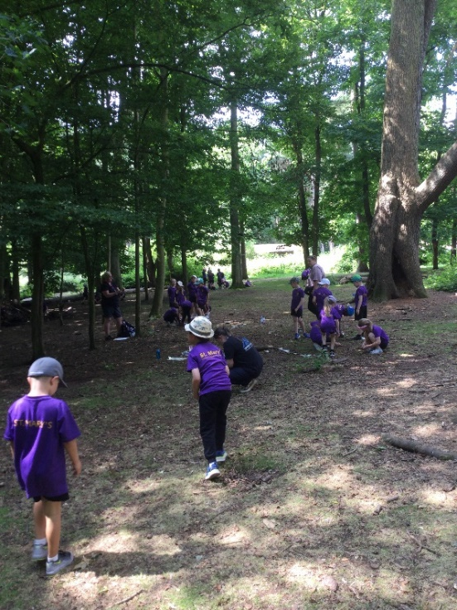
We will have lots of fun!

Slide 21

Questions
Thank you very much for listening.
Please feel free to ask any questions.

