Slide 1


Welcome to Year 3 and 4

Slide 2
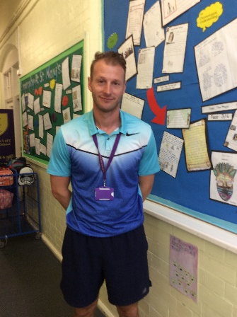
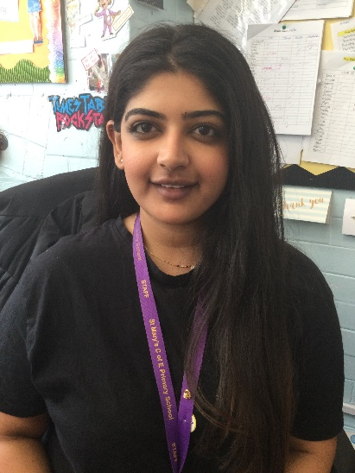
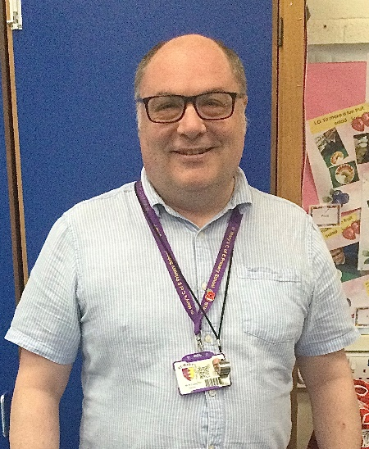
Meet the staff
Teachers
Mr Roper
(Head of phase and Newton class teacher)
Mrs Rajpara
(Chanel class teacher)
Mr Cramp
(Gaudi class teacher)

Slide 3
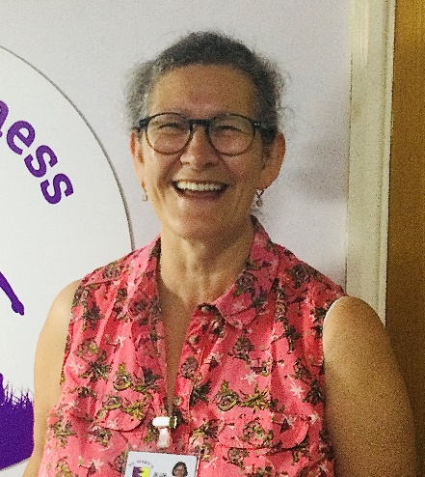
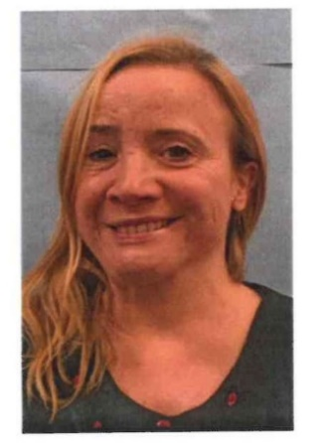
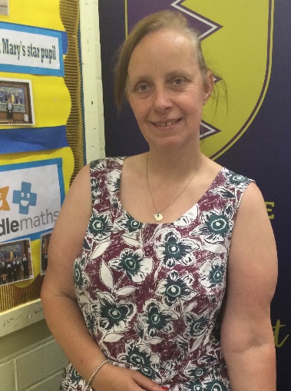
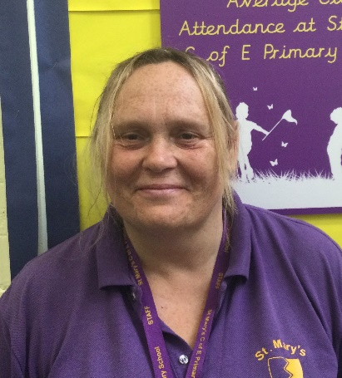
Meet the staff
Teaching assistants
Mrs Burt
(Gaudi class teaching assistant)
Mrs Sheppard-Bools
(Newton class teaching assistant)
Mrs Potter
(Braille class teaching assistant)
Mrs Williams
(S.E.N.D. support teaching assistant)

Slide 4
Routines & expectations
Topics
Questions

Slide 5
Routines & expectations
- We will have PE twice per week (days to be confirmed next year – we think it will be Thursday and Friday)
Each day will begin at 8:45am (children can be dropped off at the main playground at 8:40am) and the school day ends at 3:15pm
Your child will enter and leave each day through the door leading on to the main playground.
Please supply your child with a pull up spout water bottle to avoid spills (as these are less likely to cause spills in the classroom).
No bags to come to school
Homework is due in by Friday of each week

Slide 6


Routines & expectations – PE kit
Earrings should not be worn on PE days (unless your child can take out their own earrings). We cannot put tape over earrings. If earrings cannot be removed, your child will have to miss their PE lesson.
If your child is getting their ears pierced, please ensure this happens at the start of the summer holidays, as they will not be able to remove their earrings for the first 6 weeks after getting them pierced.
Long hair should be tied up.
PE kits (including suitable footwear) should be worn to school on PE days. Plain black shorts / trousers should be worn.

Slide 7
Homework
Homework is expected to be handed in by Friday of each week.
If a child does not hand in their homework on a Friday, there is a short detention at the start of Friday lunchtime
Weekly homework includes:
Reading diary (5 reads per week) – all reads need to be signed by an adult
Times tables book
Spellings to be learned

Slide 8
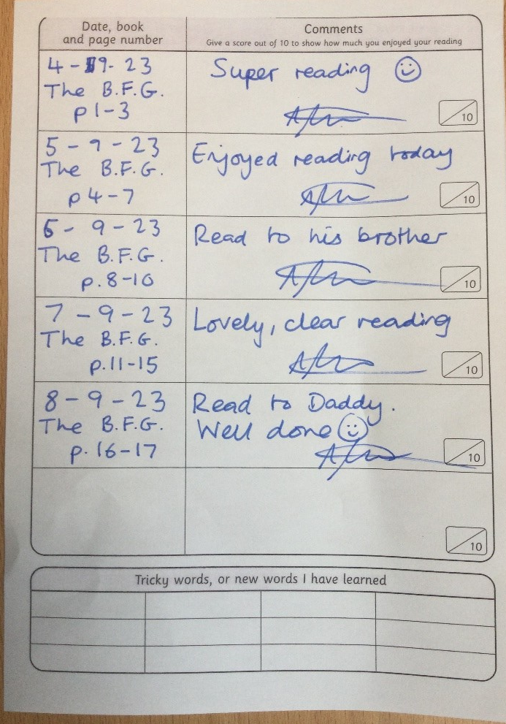
Homework
Reading diary
Each week, your child is expected to read at least 5 times. Each read must be recorded in their reading diary and signed by an adult
This should be handed in by Friday of each week

Slide 9
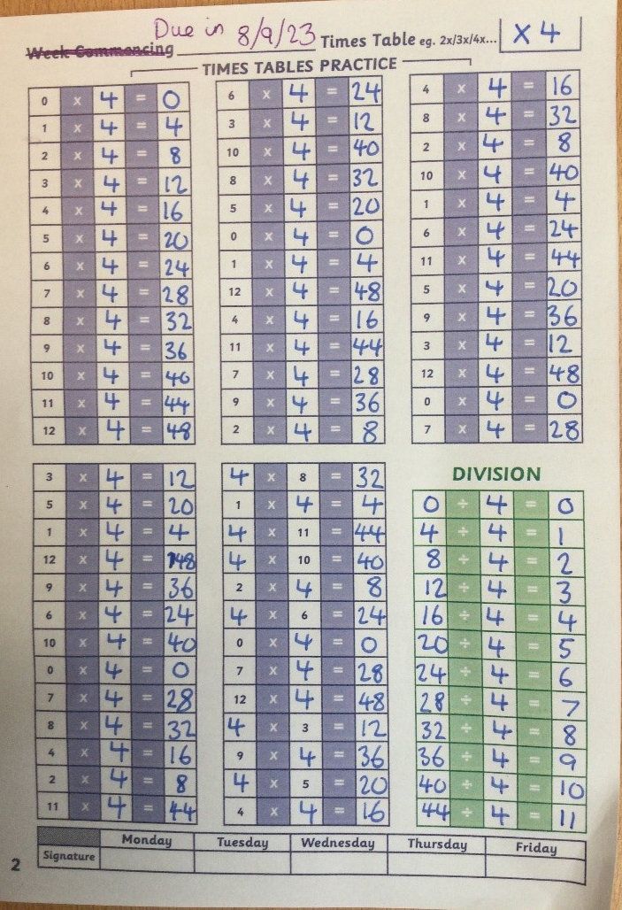
Homework
Your child will have a times tables book.
Each week, they will be expected to complete one page – their maths teacher will let them know which times tables they need to do.
Times tables books should be handed in by Friday of every week.

Slide 10
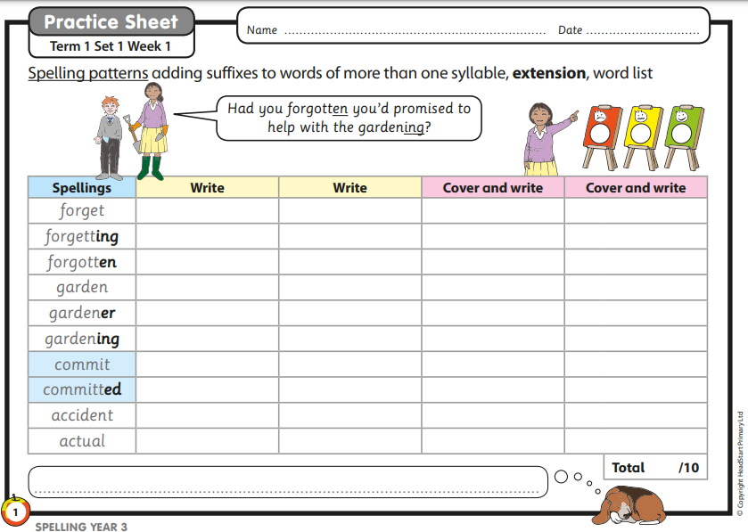
Homework
We do a spelling test every Friday, based on the spellings your child has learned during the week.

Slide 11
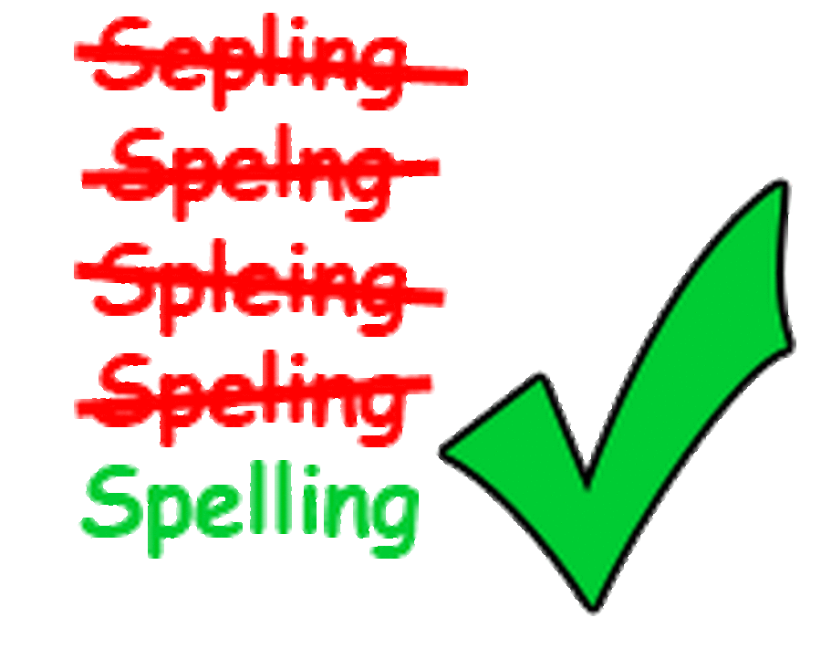
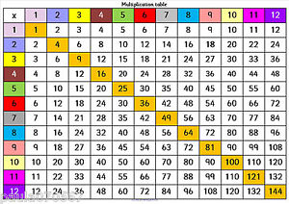
Expectations - homework
All children carry out a Multiplication Tables Check at the end of year 4.
We have a high expectation of all children by the end of year 4 to have a secure knowledge of their times tables facts.

Slide 12



Expectations
We think reading is vital for all children.
We give children lots of opportunities to read in school each day and we hear them read as often as possible.

Slide 13
Thank you for listening. To find out up-to-date information, check: - Twitter: @StMarys_Hinck - The school’s FaceBook page - The school’s website: Are there any questions?
https://www.stmarys.leics.sch.uk/

