Slide 1
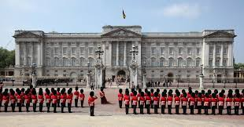
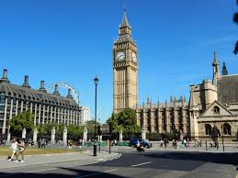
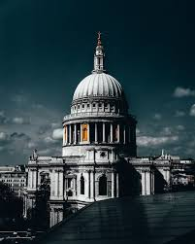
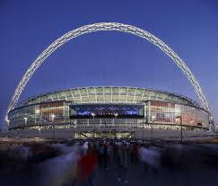
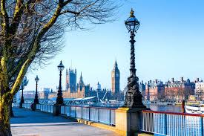
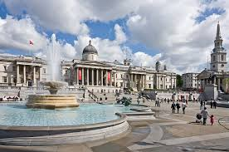
London Tour
June 3-5th

Slide 2
Staffing
Mr Cramp
Mrs Potter
Miss Linton
Miss Hewins
Mr Roper
Mrs Rajpara
Mrs Talbot

Slide 3

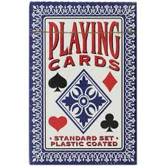
Packing
Please make sure all clothes are named and that your child knows what is being packed. Your child will need clothes and toiletries for three days.
A towel will be needed but not bedding. Please make sure that your child can carry their own bag as they may have to carry it upstairs in the hotel.
Please supply a light coat and comfortable shoes.
Children may bring a book/ magazine or card game for the journey.
If your child is travel sick, please make sure they have had a tablet on the morning of departure and HAND IN a tablet for the return journey.
All children need a refillable water bottle.
Sweets can be brought along but nothing hard boiled. Chewing gum MAY NOT to be eaten. Please do not send fizzy drinks for your child.
Children CANNOT bring a mobile phone but may wish to bring a disposable camera - no other camera should be brought.
Spending money in a named purse/wallet – no adult looks after this and the amount is up to you.
There is no guarantee that we will visit a shop and prices will be high IF WE DO.

Slide 4

Medicines
If your child is in 5/6 please take you medicine to Miss Hewins on arrival to school on Wednesday – the day of departure.
If your child is in 3/4 please take you medicine to Mrs Potter on arrival to school on Wednesday – the day of departure.
Everything must be labelled and timing clearly visible.
All staff will record medication and it will be returned, in person, on return back to school on Friday.

Slide 5
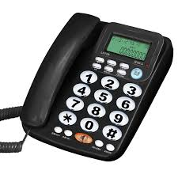
Whilst we are there.
We will inform the office when we arrive in London and a message sent on Arbour will be sent out to notify you.
If you need to contact your child due to an emergency whilst we are away, please contact the school who will then contact a member of staff.
Due to the number of children and the amount of tourists, it is important that your child is aware and stays close to the adult in charge of them- please could you reinforce this at home.

Slide 6
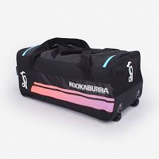
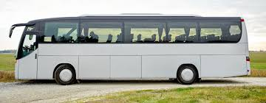
Day of departure
Please be at school by 7:40 .
Please only park in the pay and display car park and not on the road so that the coach can get as near to school as possible.
Your child will go to their adult waiting in the playground – please could you say goodbye at the gate and allow your child to take their bag to the line.
If you need to give any medicines in give them to Miss Hewins – Year 5/6 and Mrs Potter Year 3/4.
Your child will need a packed lunch in a disposable bag that can be thrown away at the end of lunch. Not to be left in their case or bag. Please can we ask that no cutlery is given to your child unless it is disposable. No lunchboxes please.

Slide 7

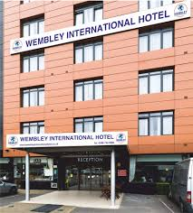
Day of departure continued - Wednesday 3rd June
We aim to leave school around 8 and as the itenary is set, we must leave swiftly.
We will be stopping en route for a comfort break and should arrive in London around 11.15.
We will notify school to say we have arrived and if we have an up-to-date phone number for yourselves, you will receive a message on Arbour.
We will visit The Science Museum
Sightseeing coach tour of London
Dinner at The Hard Rock Café at Piccadilly Circus
Arrive at Wembley International Hotel

Slide 8
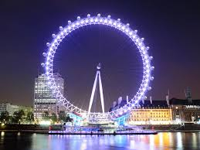
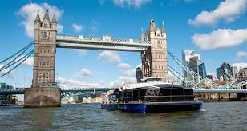
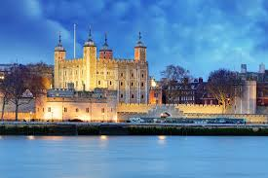

Thursday 4th June
We will visit The Tower of London
River Thames boat cruise is next
Followed by a flight on the London Eye
Dinner at Pizza Express today
To finish the day we arrive at the Apollo theatre to watch - Wicked

Slide 9
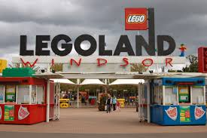
Friday 5th June
Leave hotel
Legoland Windsor
Approximate arrival back to school is 6.00 pm
You will be notified if there are any changes to the time of return through Arbour.
Please, we ask that you are prompt collecting your child and that you do not park on the road but in a car park so that the coach can have easy access.
If you gave medicine in, please ensure that you collect it when once we return to school.

